Slide 1
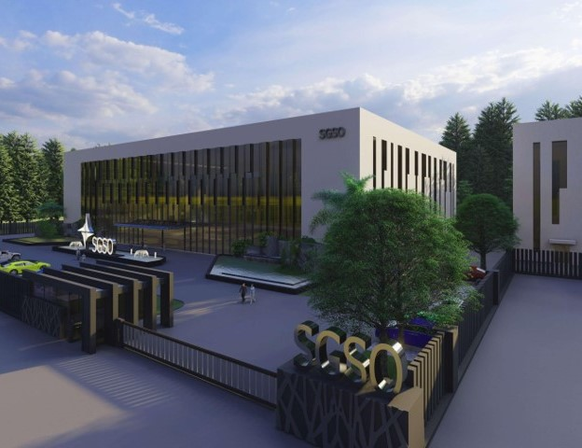

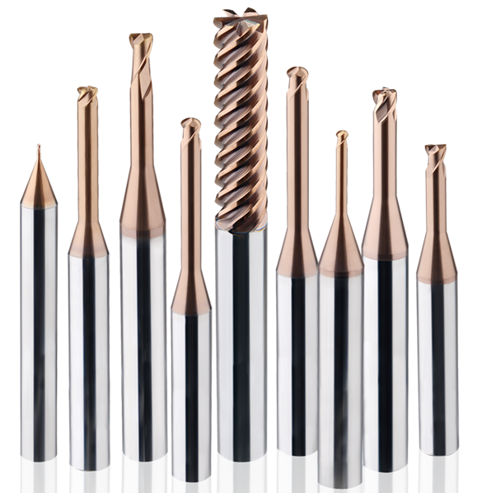
Miniature Deep End Mill
Notes:
Sustained Growth Smart Optimization

Slide 2
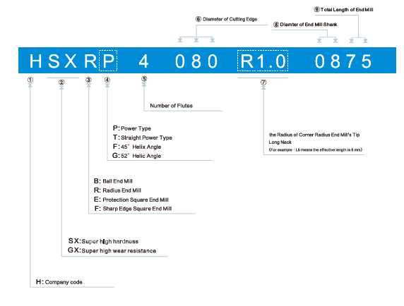
Item Code
L8
Under neck length

Slide 3
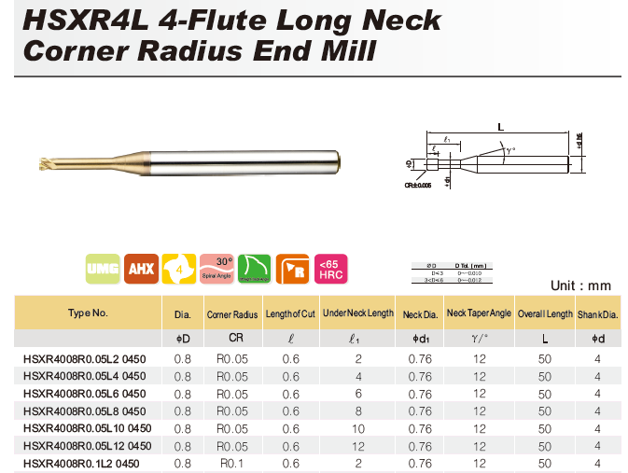
Item Code

Slide 4

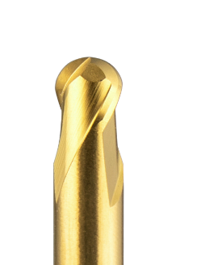
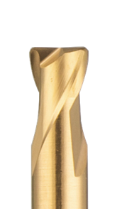
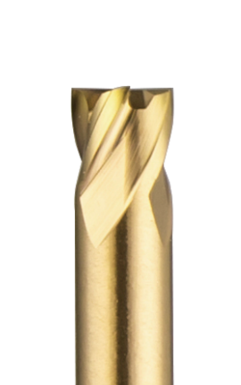
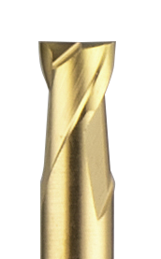
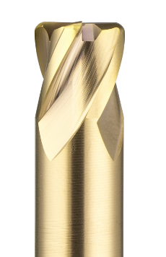
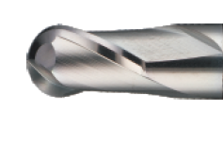
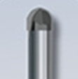
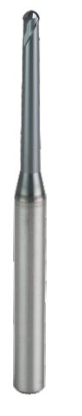
Deep Series

Slide 5
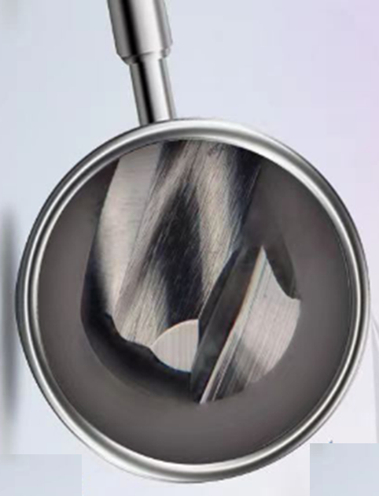
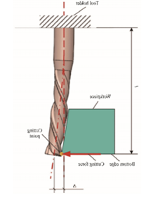


Features – Water Drop Geometry
D>1mm
D<1mm
Water drop geometry for small diameter avoids excessive contact of cutting edge and workpiece during deflection
Deflection caused by cutting force
deflection

Slide 6

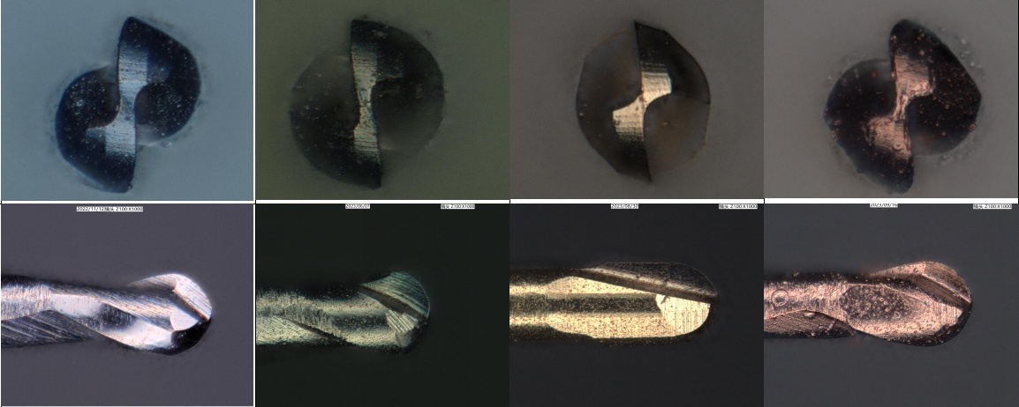
Products – Precision R0.05mm
N company
M***230
U company
H***2001
H company
EP***2001
HGXB2001 0450 P

Slide 7
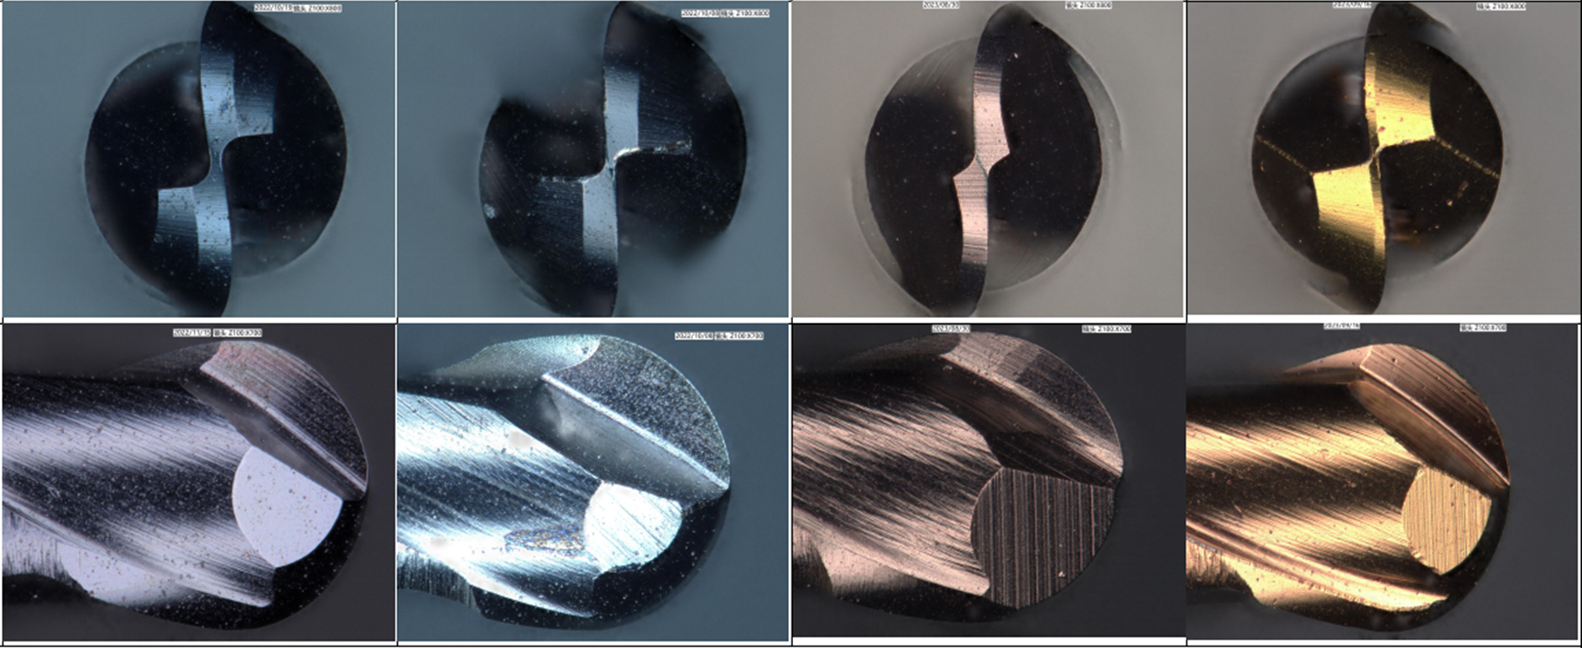
Products – Precision R0,15mm
N company
M***230
U company
H***2003
H company
EP***2003
HGXB2003 0450 P

Slide 8

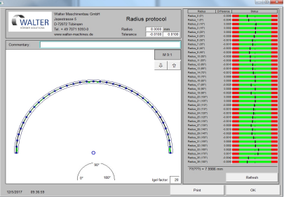
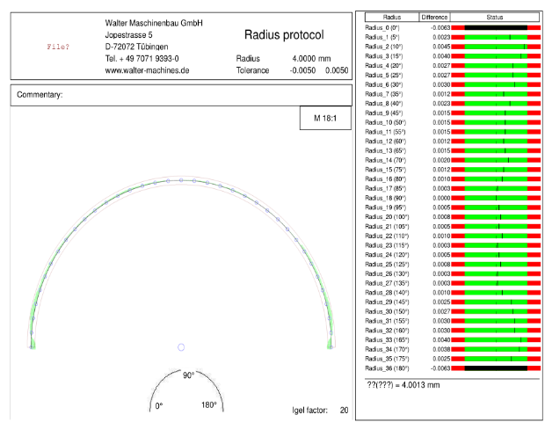
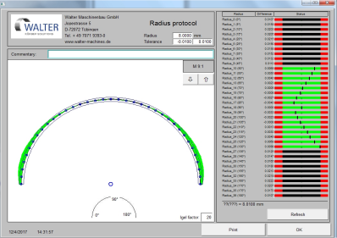
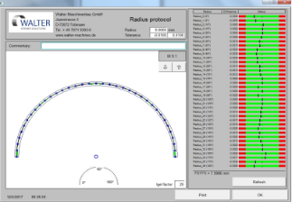
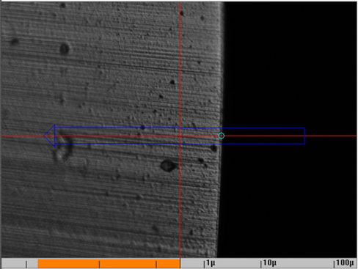
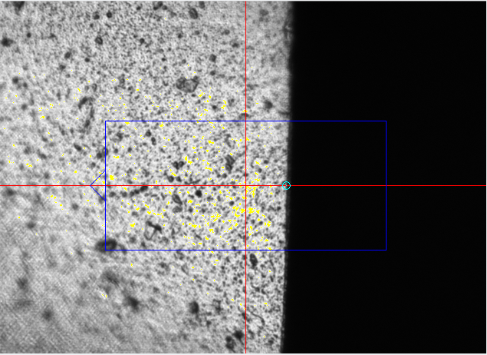
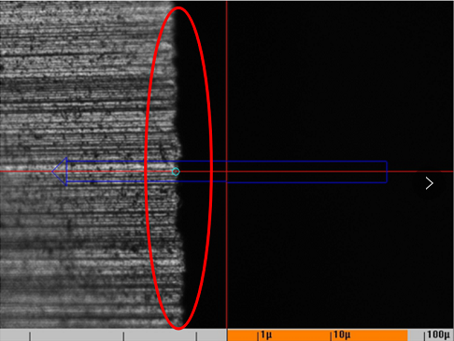
High Precision
H company
Z company
All in range
Two side out of range
Out of range
Radius Tolerance
Diameter＜1mm
+/-0.003mm (+/-0.0015mm)
1mm≤Diameter≤12mm
+/-0.005mm
Diameter＞12mm
+/-0.008mm

Slide 9
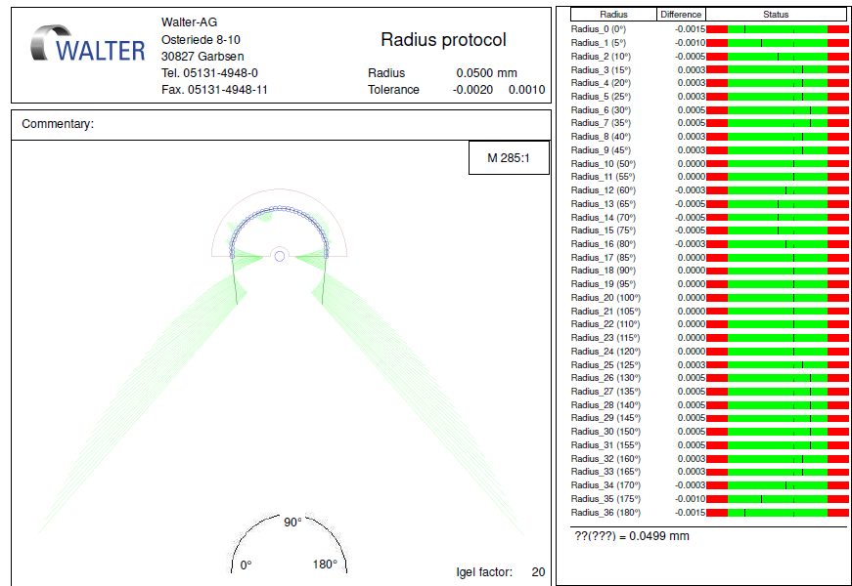
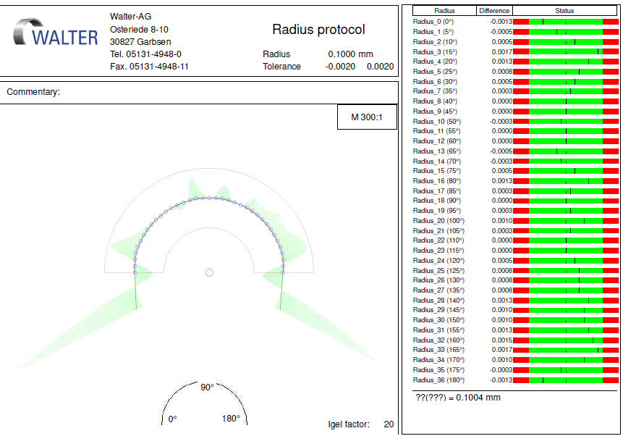
Products - Precision
HGXB2001L0.2 0450 (R0.05mm Ball nose)
Tolerance: -0.002/+0.001mm
HGXB2002L1 0450 ( R0.1mm Ball nose)
Tolerance: -0.002/+0.002mm
Notes:
The mill’s ball nose accuracy can be controlled between R ± 0.0015 mm.

Slide 10
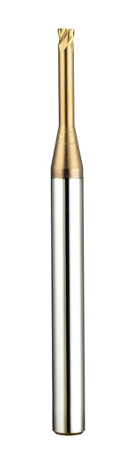

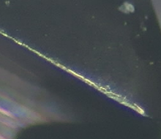
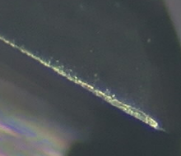
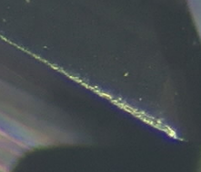
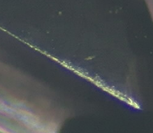
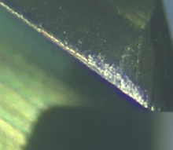
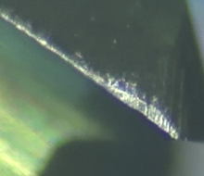
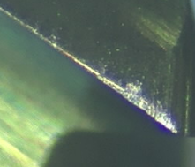
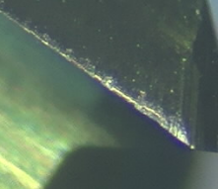
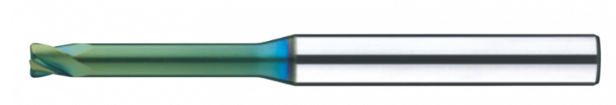
Successful Story – HSXR2L
Machine：Quick Jet 1612
Holder： HSK63 – SKL2
Cutter： D2xR0.2xL10
Material：1.2083ESR HRC50
Cutting： Finishing
Coolant： Emulsion
Vc： 75 m/min
n： 12000 rpm
fz： 0,03mm/t
Vf： 1500mm/min
ap： 0,06mm
ae： 0,03mm
HSXR2020R0.2L10 (after 600m)
J Company 4J***020002080 (after 400m)

Slide 11

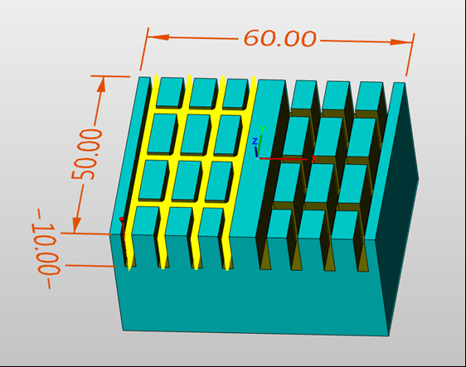
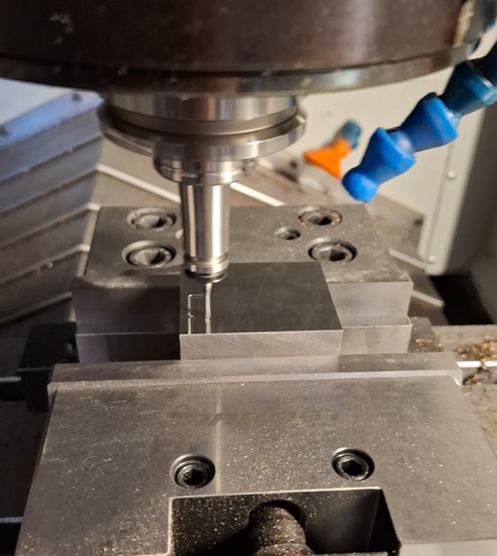
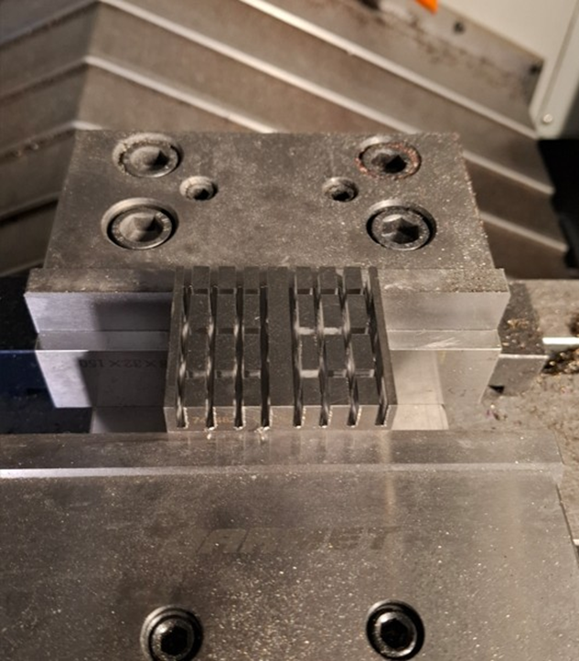

Successful Story – HSXE2L
Machine：Makino
Holder： PowRgrip. HSK63
Cutter： D2xL20
Material：1.2343ESR HRC52
Cutting： Z constant slotting
Coolant： Emulsion
Vc： 80 m/min
n： 12700 rpm
fz： 0.03mm/t
Vf： 760mm/min
ap： 0.03mm
ae： 2mm-0.2mm
Machine Time: 90min
HSXE2020L10 0450
Customer Comments:
We tested the following items for comparison
SGSO HSXE2020L10 0450
H company E****-2020-10-ATH
N company M**230 08-00200-20100
There is no big difference in tool wear, but SGSO created much better tolerance in width of ribs.

Slide 12
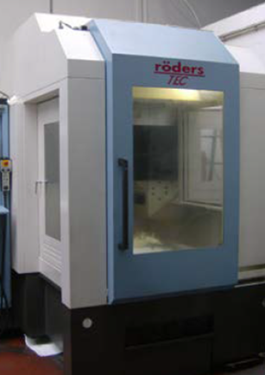
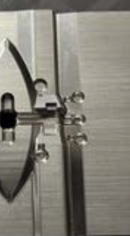
Successful Story – HSXB2L
Machine：Roeders
Holder： PowRgrip. HSK40E
Cutter： D1xR0,5xL4
D2xR1xL6
Material：1.2343ESR HRC54
Cutting： Z constant
Coolant： Airblow
Customer Comments:
We compared SGSO with H company MR***230SF, finally SGSO reached smaller wear and the surface quality after finishing is also better than competitor
HSXB2020L6 0450
HSXB2010L4 0450

Slide 13
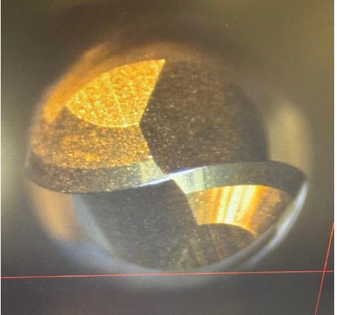
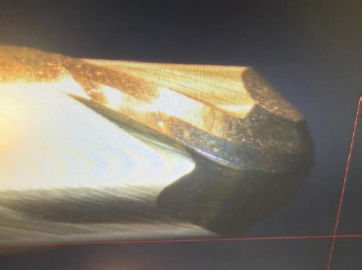
Successful Story – HSXB2L
Machine：GF HPM80
Cutter： R1,5xL16 Ball nose
Material：DAC Magic 48HRC
Cutting： Copy milling
Coolant： Airblow
Vc： 130 m/min
n： 14000 rpm
fz： 0,057mm/t
Vf： 1600mm/min
ap： 0,1mm
ae： 0,1mm
Cutting Time 192 min
Customer Comments:
After more than three hours using,
There is still very small wear, possible
For further using. Much better than current competitor
HSXB2030L16 0660

Slide 14
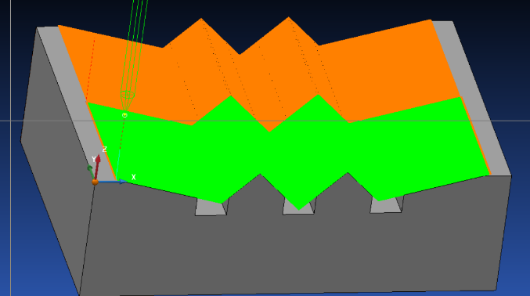
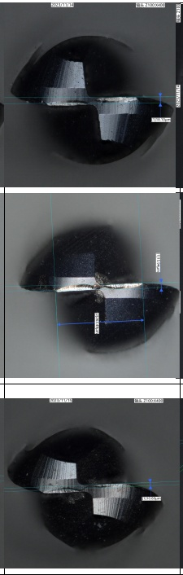
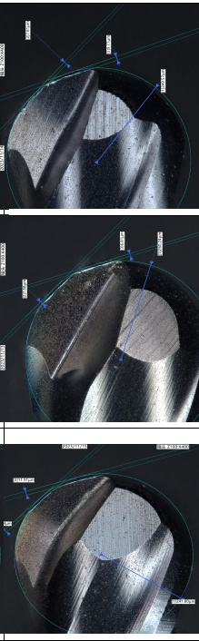
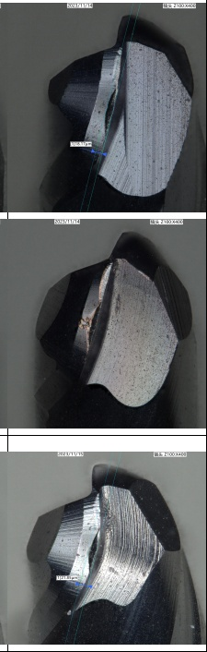
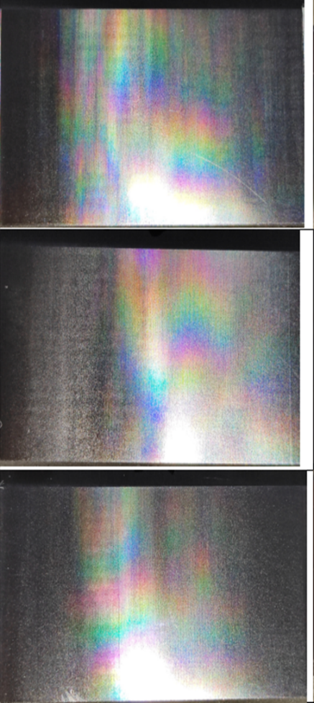
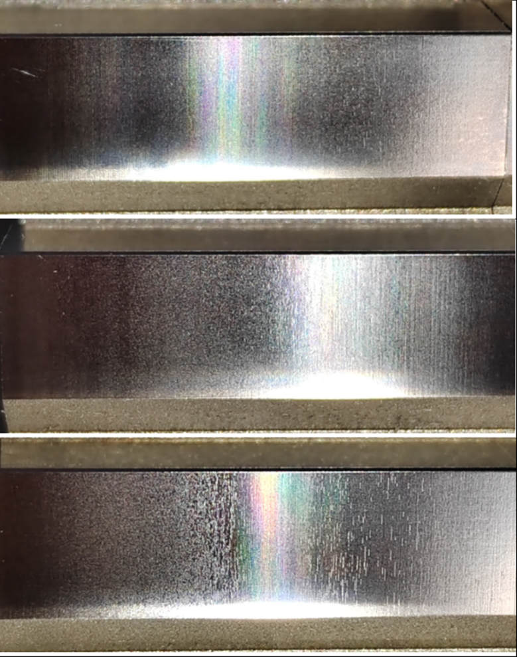
Successful Story – HGXB2L
Machine：Quickjet AV70S
Holder： MST HSK E50-SLRA4
Cutter： R0.25xL2 Ball nose
Material：1.2343ESR HRC50-52
Cutting： 15°&45° slope face finishing
Coolant： Emulsion
Vc： 40 m/min
n： 25000 rpm
fz： 0,01mm/t
Vf： 500mm/min
ap： 0,01mm
ae： 0,025mm
Wear after 7hours
15° face
45° face
HGXB2005L2 0450
N company
O company

Slide 15
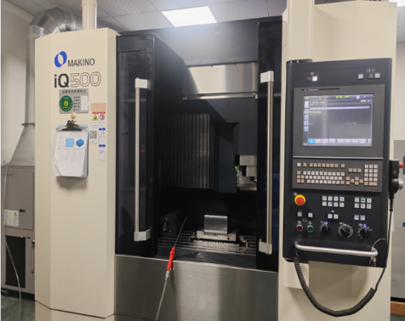
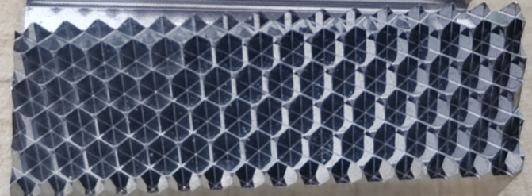





Successful Story – HGXB2L
Machine：Makino IQ500
Holder： HSK-E32-SLRA4-22
Cutter： R0.1xL1 Ball nose
Material：X36CrMo17 (1.2316) HRC52
Cutting： Z constant finishing
Coolant： Emulsion
Vc： 22.6 m/min
n： 36000 rpm
fz： 0,004mm/t
Vf： 300mm/min
ap： 0,01mm
ae： 0,02mm
After 1,5 hours
After 14 hours
HGXB2002L1 0450
N company

Slide 16









Successful Story – HGXB2L
Machine：Makino AV70S
Holder： HSK E50
Cutter： R0,25xL2 Ball nose
Material：1,2343ESR, HRC50
Cutting： Z constant semi finishing
Coolant： Emulsion
Vc： 157 m/min
n： 25000 rpm
fz： 0,01mm/t
Vf： 500mm/min
Ap: 0,01mm
Ae: 0,025mm
3,5 hours
HGXB2005L2 0450
H company

Slide 17







Successful Story – HGXB2L
Machine：Quickjet AV70S
Holder： MST HSK E50-SLRA4
Cutter： R0.25xL2 Ball nose
Material：1.2343 HRC50-52
Cutting： 10° slope face finishing
Coolant： Emulsion
Vc： 40 m/min
n： 25000 rpm
fz： 0,01mm/t
Vf： 500mm/min
ap： 0,01mm
ae： 0,025mm
HGXB2005L2 0450
After 120min
N company
M***230-R025*2
After 60min
Machined surface
After 120min
Machined surface
After 60min

Slide 18


Successful Story – HGXR2L
Machine：Makino V56I
Holder： MST HSK A63-SLRK12
Cutter： D0.8xR0.05xL6 Radius
Material：1.2083 HRC50-52
Cutting： Z constant finishing
Coolant： Emulsion
Vc： 45 m/min
n： 18000 rpm
fz： 0,008mm/t
Vf： 300mm/min
ap： 0,02mm
ae： 0,01mm
Competitor N
Competitor N 1st pcs 180min
HGXR2008R0.05L6 0450
SGSO 1st pcs 180min
HGXR2008R0.05L6 0450
SGSO 2nd pcs 180min

Slide 19


