Slide 1
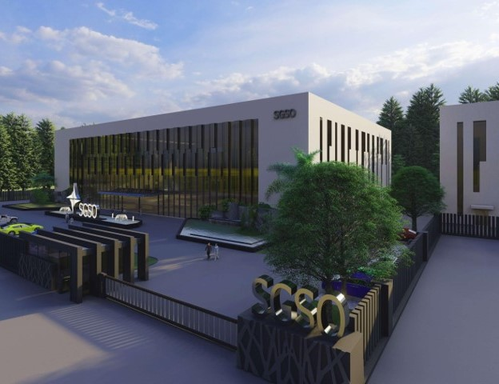

SGSO Products Positioning
Notes:
Sustained Growth Smart Optimization

Slide 2

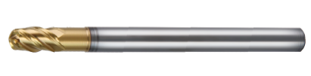


SGSO Ball Nose Endmill positioning
Hard Material
HSXB2
(2 flutes)
HSXBC4
(4 flutes)
high efficiency
Ultra-high efficiency
HGXB2
(2 flutes)
HGXB4
(4 flutes)
Soft Material

Slide 3

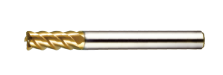
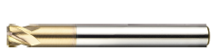
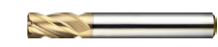
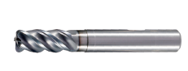
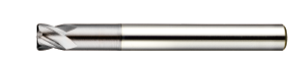
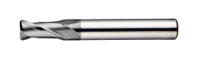
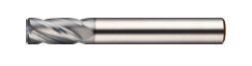
SGSO Radius Endmill Positioning
Hard Material
HSXHE4-CR
(4 or6 flutes/45 helix)
HSXEF4-CR
(4 flutes/45 helix)
HSXRP4
(4 flutes/30 helix)
HSXR4
(4 flutes/30 helix)
high efficiency
Ultra-high efficiency
HGHFE4-CR
(4 flutes/42 helix)
HGXRP4
(4 flutes/30 helix)
HGXR2
(2 flutes/30 helix)
HGXR4
(4 flutes/30 helix)
Soft Material

Slide 4
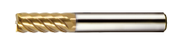
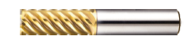
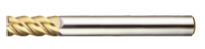
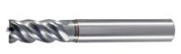
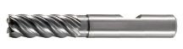
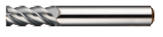
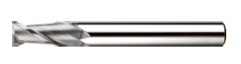
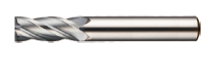
SGSO Square Endmill Positioning
Hard Material
HSXHE4/6
(4 or 6flutes/45 helix)
HSXEG6
(4 flutes/52 helix)
HSXEF4
(4 flutes/45 helix)
high efficiency
Ultra-high efficiency
HGHFE4
(4 flutes/42 helix)
HGHFE5
(5 flutes/42 helix)
HGXEF4
(4 flutes/45 helix)
HGXE2
(2 flutes/30 helix)
HGXE4
(4 flutes/30 helix)
Soft Material

Slide 5
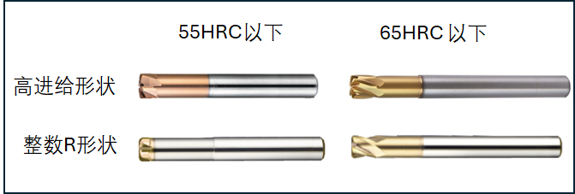
SGSO High Feed Endmill Positioning
 | <55HRC | 55-70HRC
High Feed Geometry
Real Radius Geometry
HSHFR
HSXHR
HSXRP
HSXRT

Slide 6

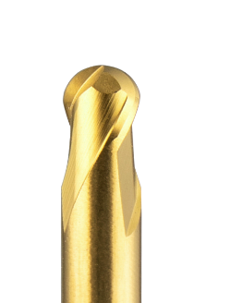
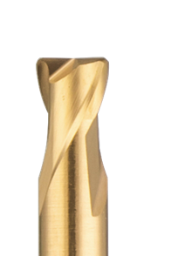
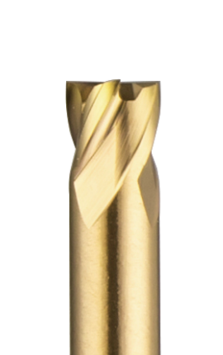
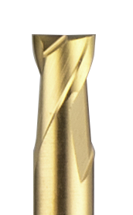
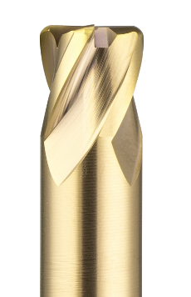
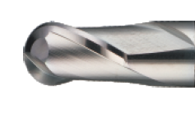
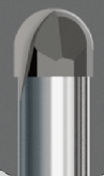
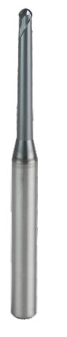
Deep Minitural Endmill Positioning

Slide 7


