Slide 1
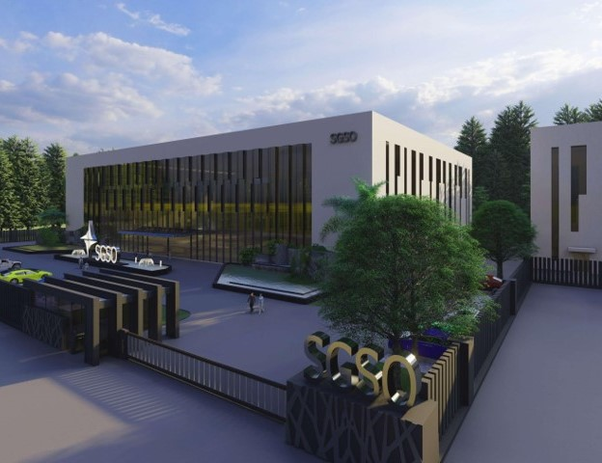

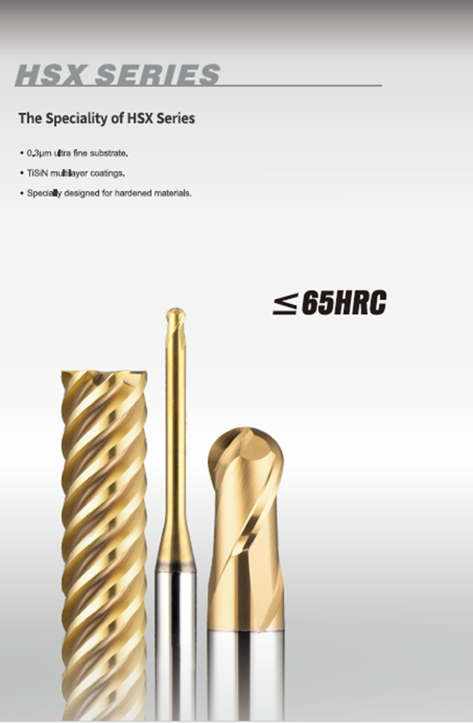
HSX Series
Notes:
Sustained Growth Smart Optimization

Slide 2

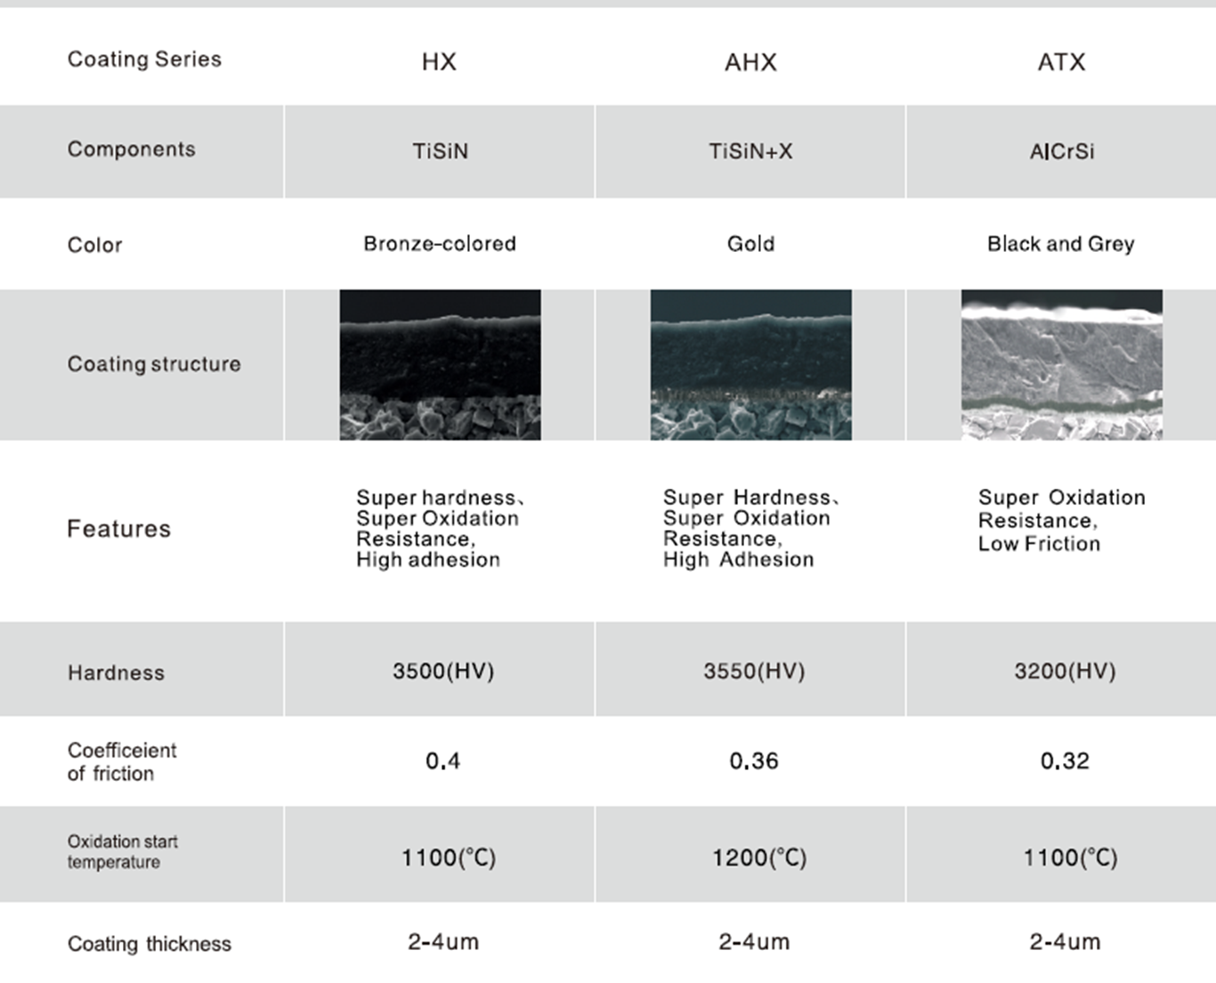
HSX (AHX coating- Nano Multiple layer structure)
Notes:
TH3 friction coefficient 0,9

Slide 3
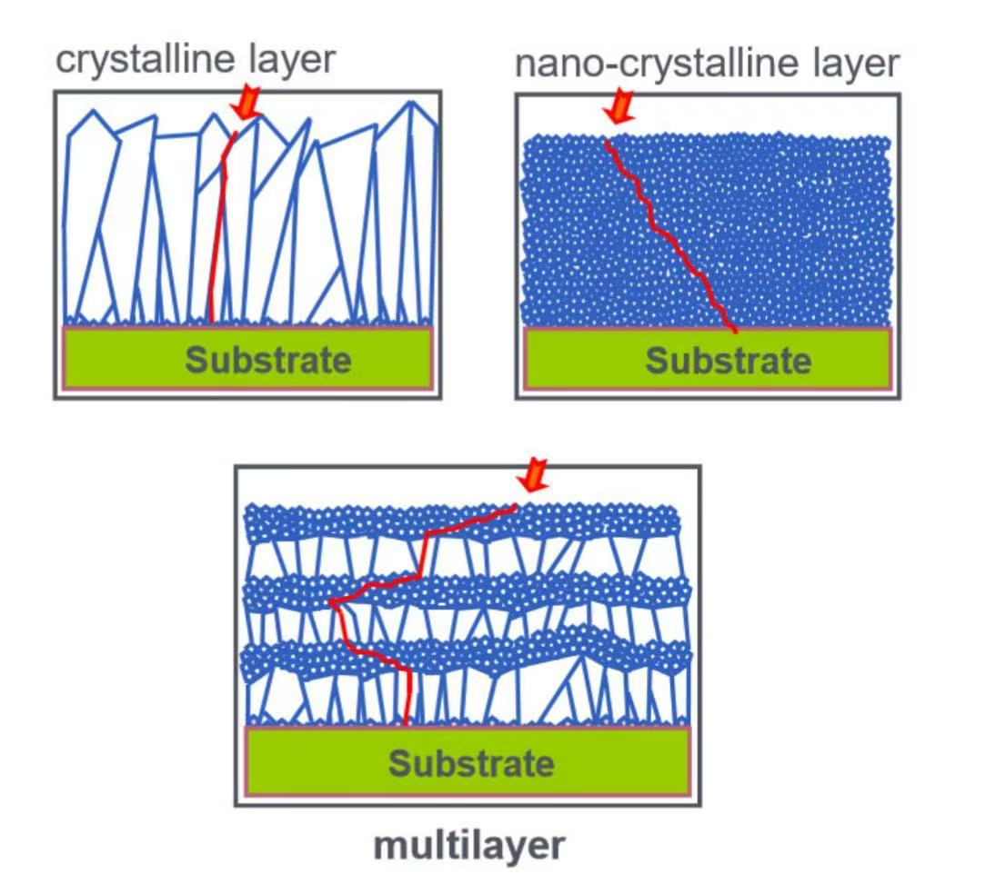
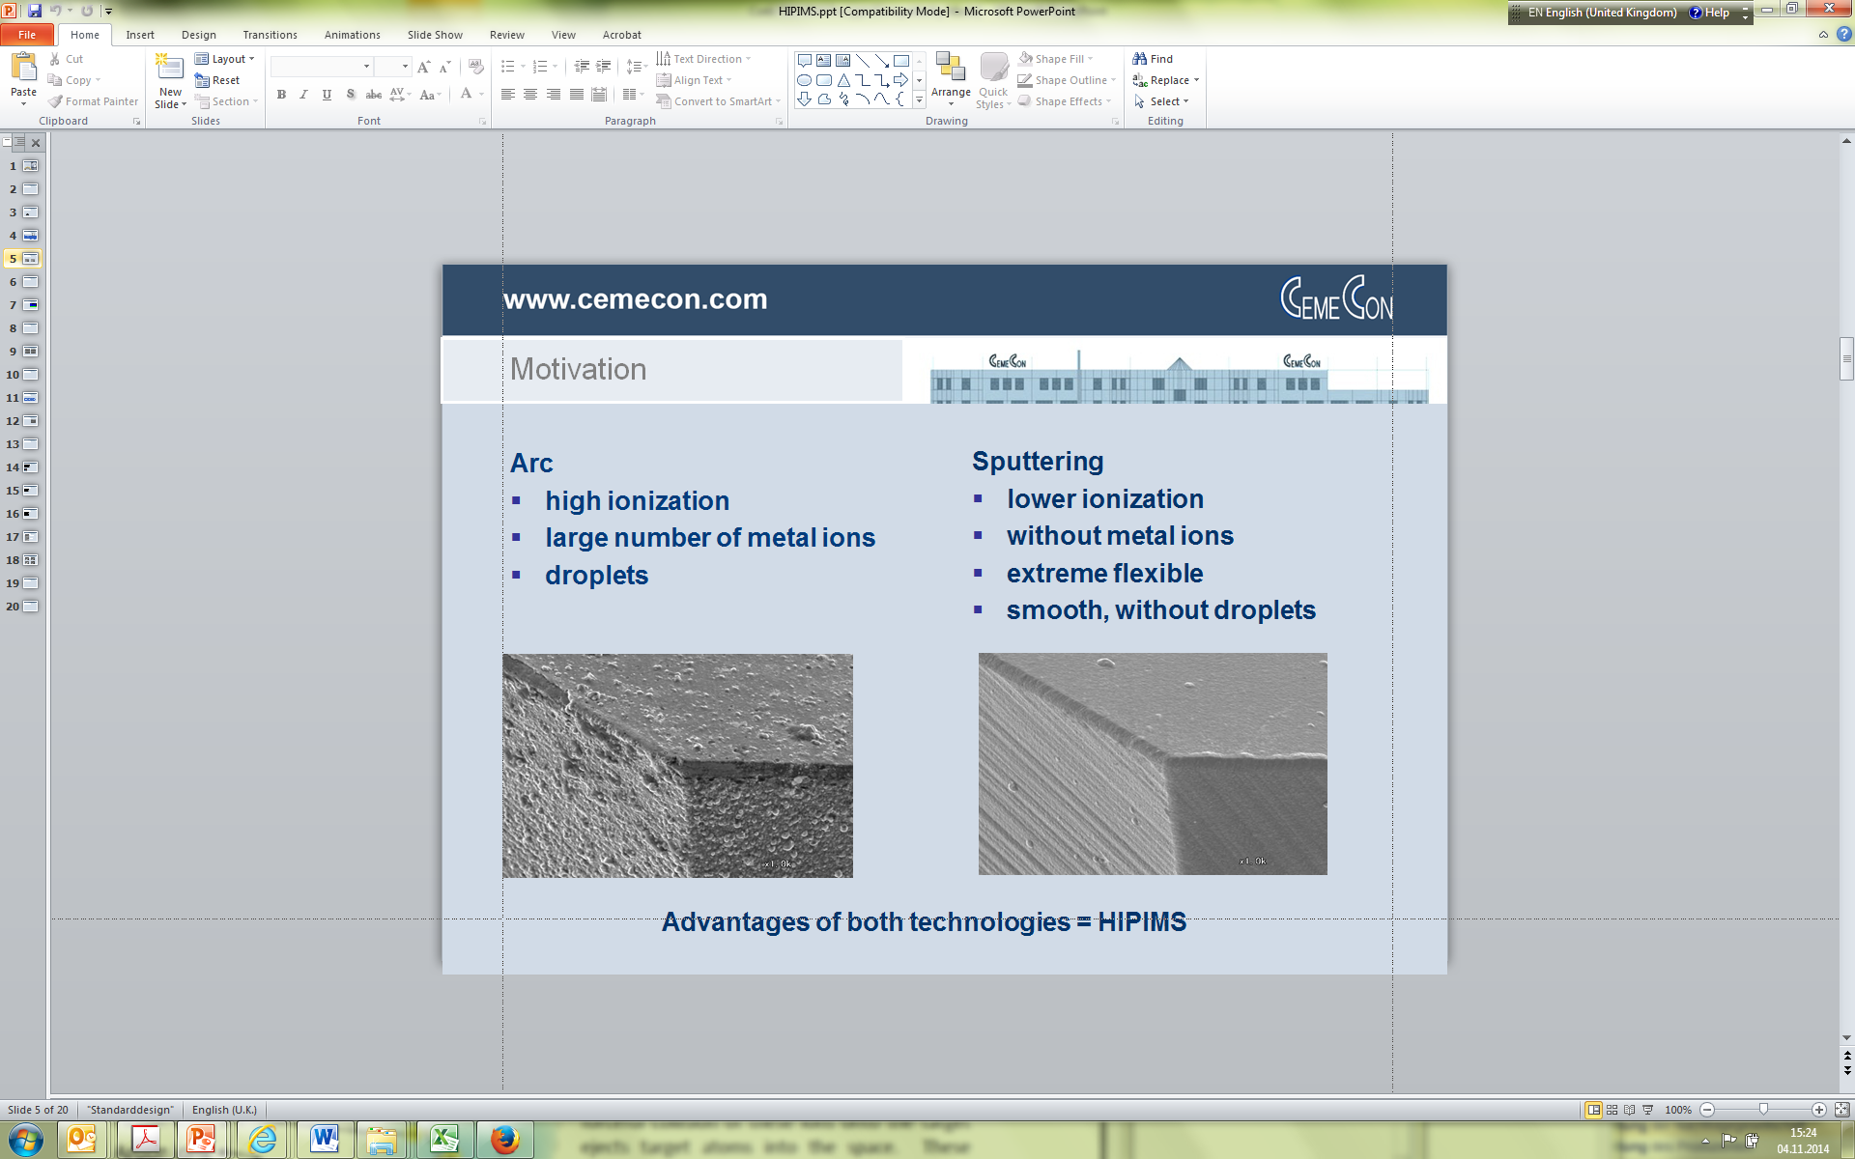
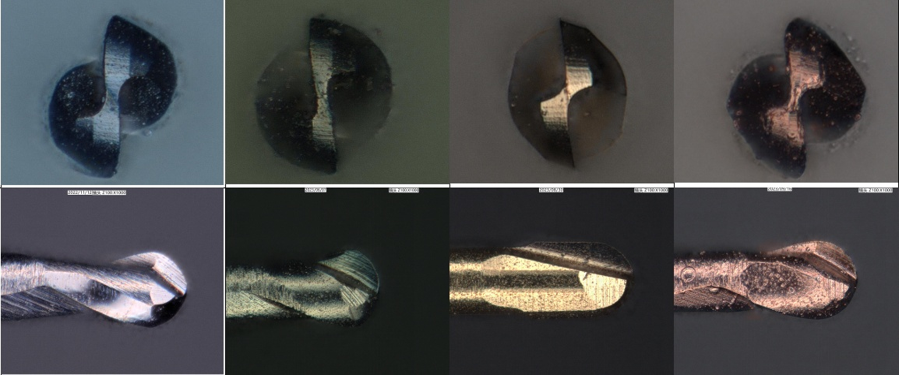

HSX/HGX coating- Nano Coating
Nano Multiple layer coating
Competitor

Slide 4

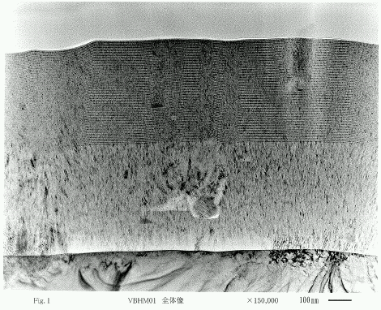
HSX/HGX coating- Multiple layer Coating
Single Layer
Multi-Layer

Slide 5
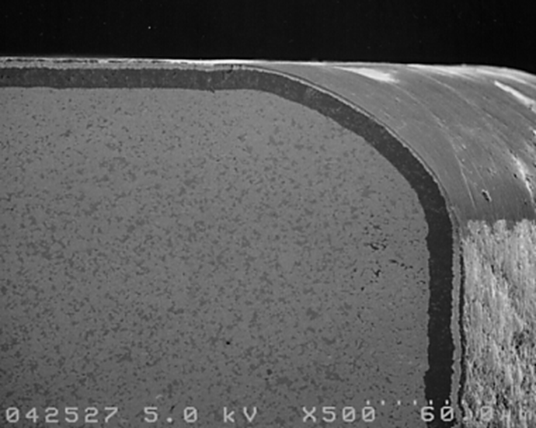
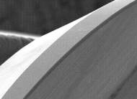
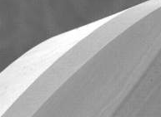


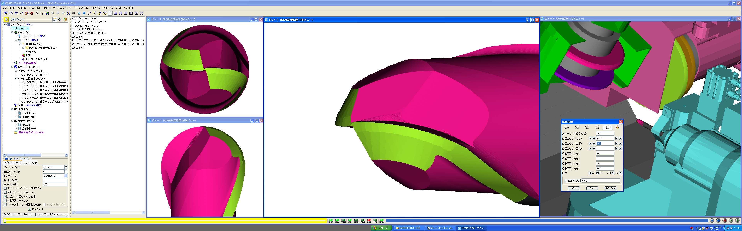

Edge Treatment
Cutting edge
with treatment
Cutting edge without treatment
Relief face
Rake face
Tougher cutting edges
Sharper cutting edges

Slide 6
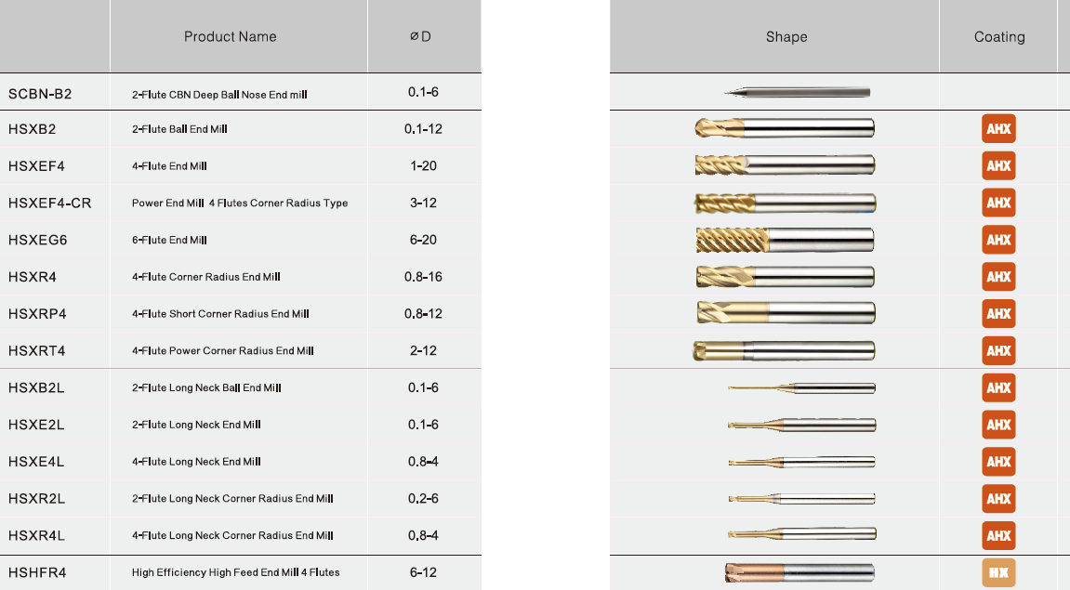
HSX Overview

Slide 7
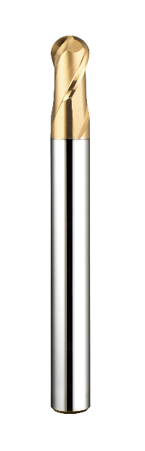
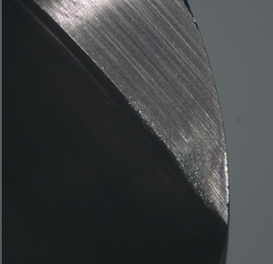
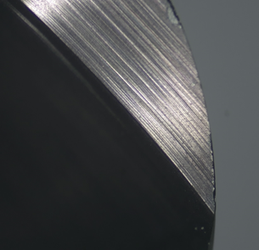
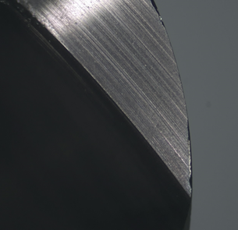
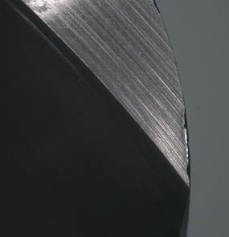

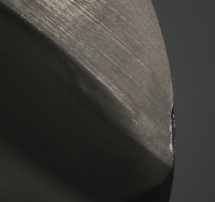
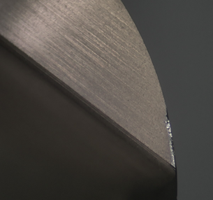
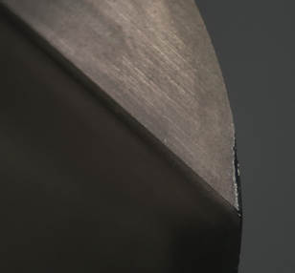
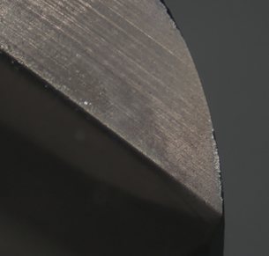
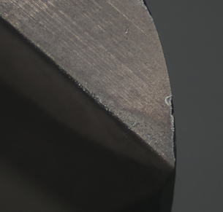
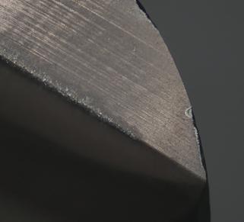
Successful Story – HSXB2 – Internal Test
36min
108min
144min
252min
HSXB2080 0875-B
U company
Machine：HSK A63 spindle
Cutter： R4x2t Ball nose
Material：1.2379 HRC60-62
Cutting： flat face finishing
Coolant： Airblow
J company
Vc： 200 m/min
n： 8000 rpm
fz： 0,187mm/t
Vf： 3000mm/min
ap： 0,05mm
ae： 0,2mm
H company

Slide 8
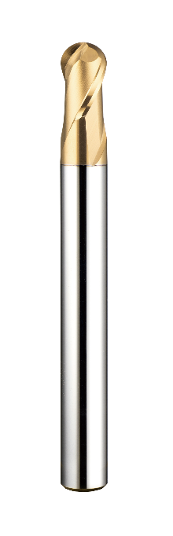
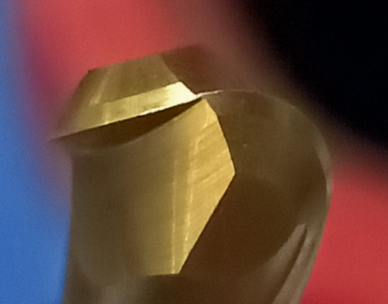
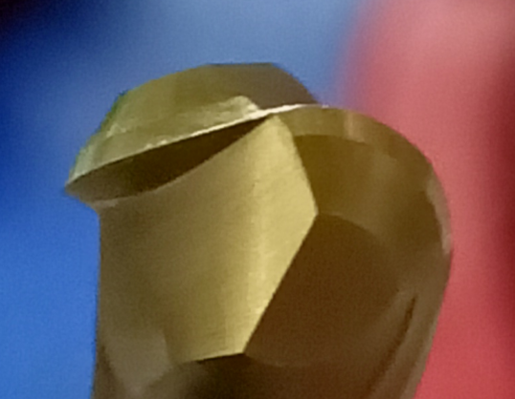
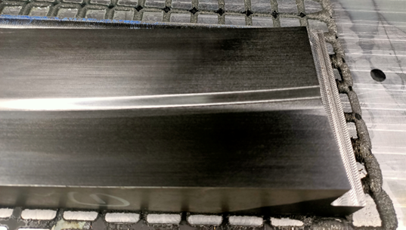
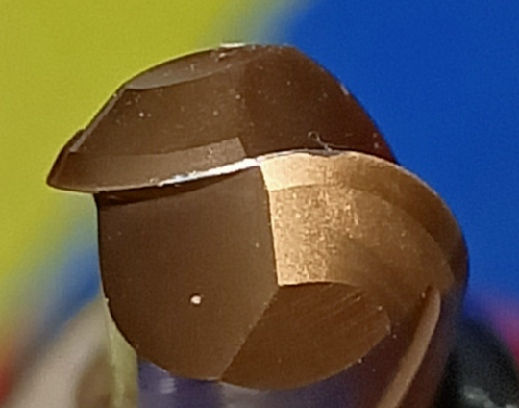
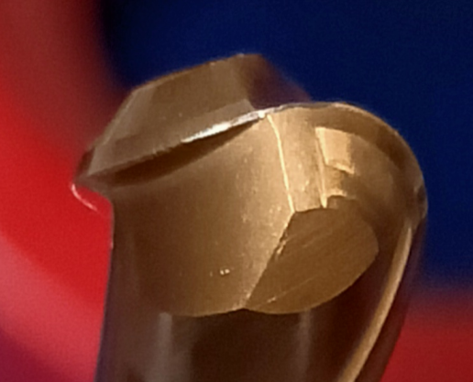
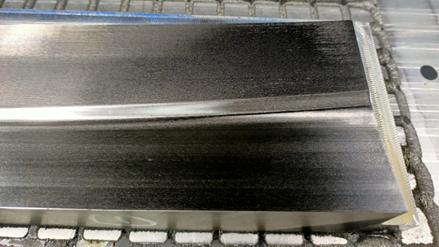
Successful Story – HSXB2 - Germany
Holder： HSK-A63-SLK12-75
Cutter： R4x2t Ball nose
Material： 1.2379 HRC52-54
Cutting： Z constant finishing
Coolant： Emulsion
Vc： 251 m/min
n： 10000 rpm
fz： 0,125mm/t
Vf： 2500mm/min
ap： 0,02mm
ae： 0,1mm
2 hours
4.5 hours
HSXB2080 0875
Center wear 0.0038mm
Center wear 0.0050mm
H company
Center wear 0.0125mm
Center wear 0.0267mm
Notes:
HGX is also better than Hitachi, but not so bigger difference as HSX

Slide 9

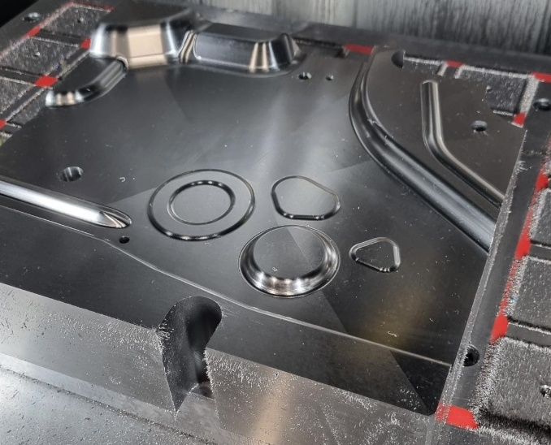
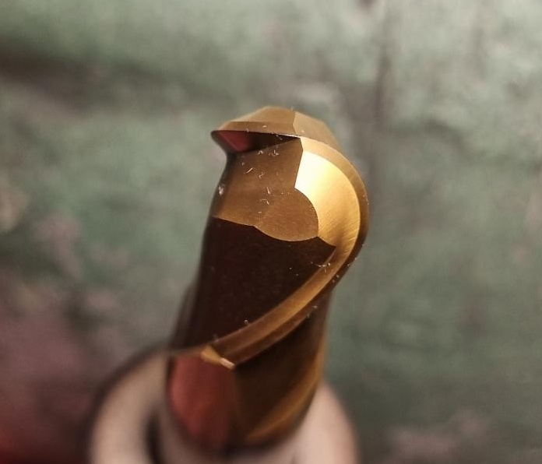
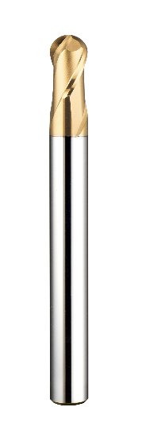
Successful Story – HSXB2 - Slovenia
Machine：HSK A63
Cutter： R6x2t Ball nose
Material：1.2379 60HRC
Cutting： flat face finishing
Coolant： Airblow
Vc： 188 m/min
n： 5000 rpm
fz： 0,18mm/t
Vf： 1800mm/min
ap： 0,1mm
ae： 0,2mm
HSXB2120
Cutting Time 7 hours
Customer Comments:
Amamzing! After 7 hours finishing, there was no obvious wear on the cutting edges, it could be used for another 7 hours.

Slide 10
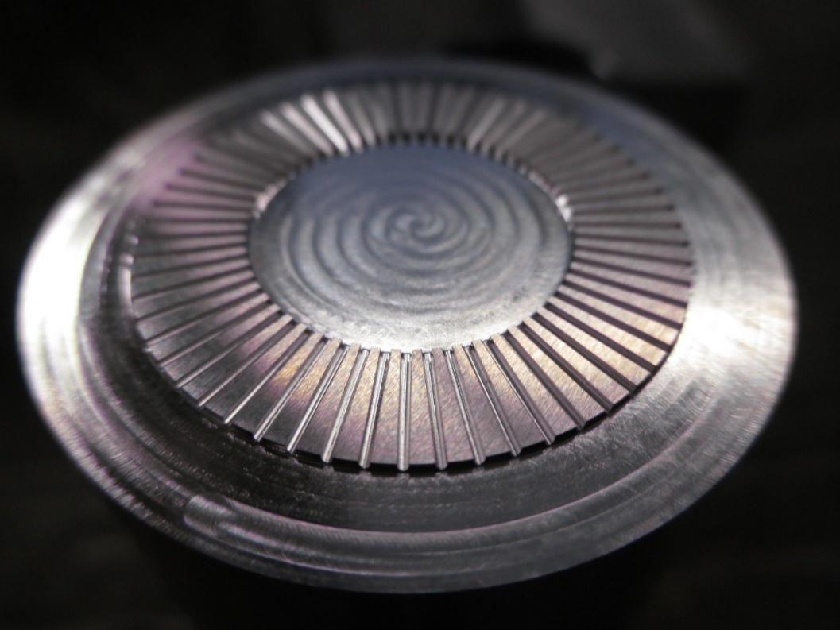

Successful Story – HSXB2 - Germany
Machine: OPS650
Cutter: R0,5 Ball nose
Material: 1.2379 HRC58
Cutting：Slotting
Machining time : 40min
Vc： 70 m/min
N: 22293rpm
fz： 0,01mm/t
Vf: 446mm/min
ap： 0,01mm
ae： 1mm
HSXB2010L3 0450
Customer Comments:
After one parts 40 minutes, no obvious wear, even in slotting application for hard material.

Slide 11
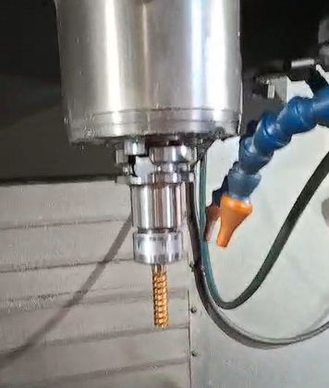
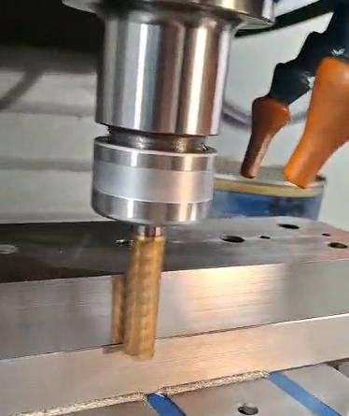
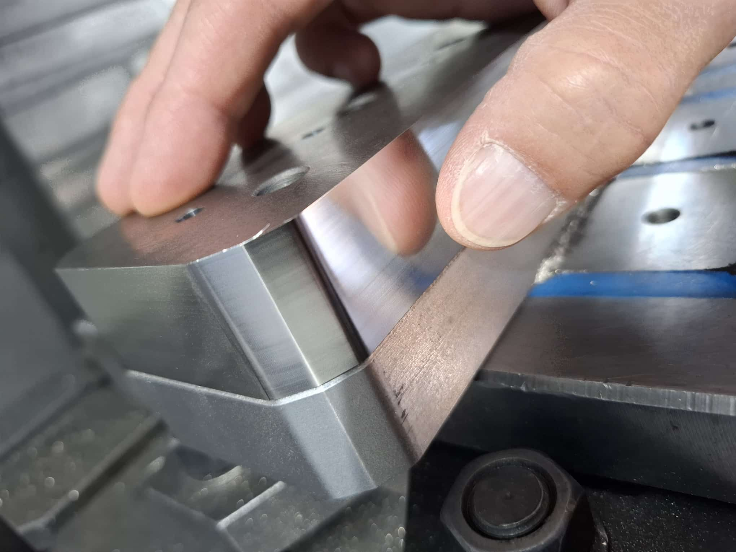

Successful Story – HSXEG - Spain
Cutter： D12x6t Square Endmill
Material：HWS 60HRC
Cutting： Wall finishing
Coolant： Airblow
Vc： 75 m/min
n： 2000 rpm
fz： 0,05mm/t
Vf： 600mm/min
ap： 30mm
ae： 0,05mm
Customer Comments:
The customer were stastfied with
The shining surface qualtiy.

Slide 12
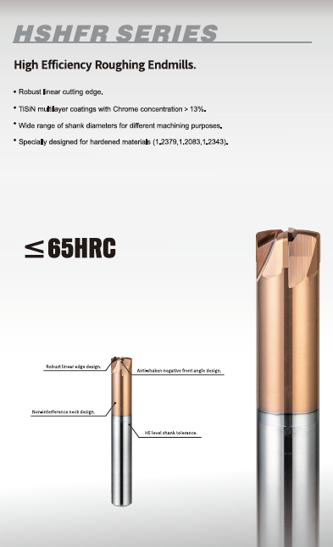

Products – HSHFR
Holder： HSK A63
Cutter： D8x4t High feed endmill
Material： 1.2343 52HRC
Cutting： Z constant roughing
Coolant： Air blow
Conventional
HSHFR
Vc： 125 m/min
n： 5000 rpm
fz： 0,125mm/t
Vf： 2500mm/min
ap： 0.2mm
ae： 4.8mm
Vc： 125 m/min
n： 5000 rpm
fz： 0,225mm/t
Vf： 4500mm/min
ap： 0.28mm
ae： 4.8mm

Slide 13
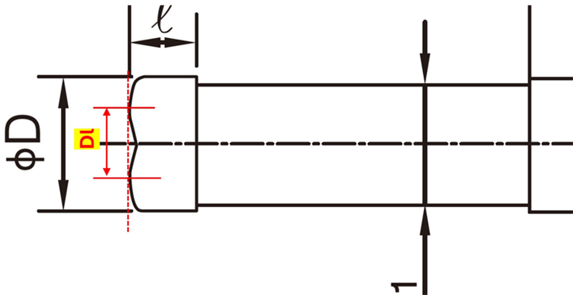
Products – HSHFR

Slide 14
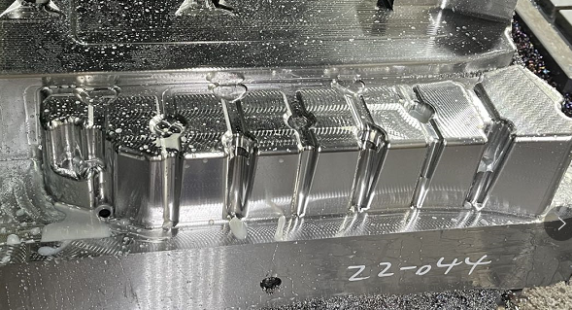
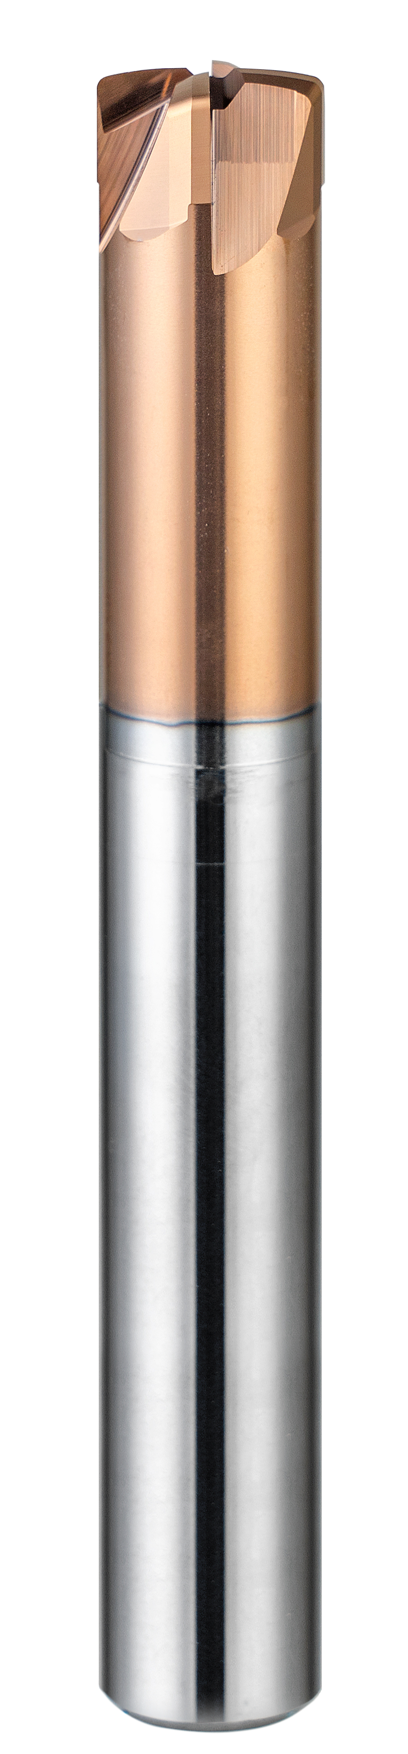
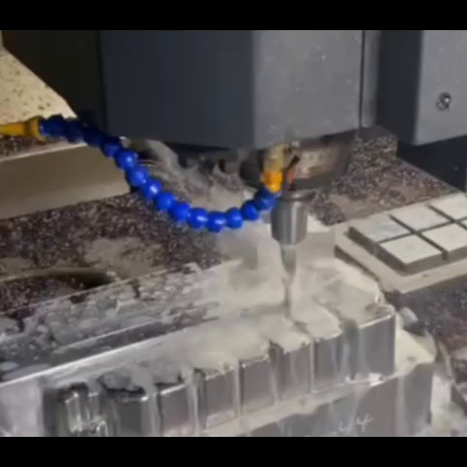
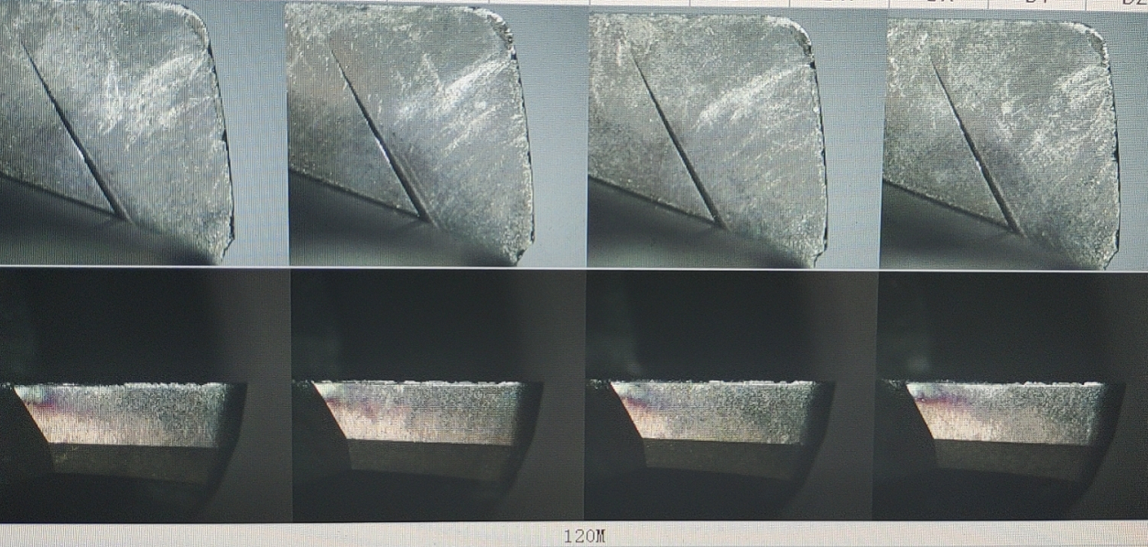
Successful Story – HSHFR - Germany
Machine: OPS650
Cutter: D8 High feed
Material: DIEVAR HRC48
Cutting：Z constant
Vc： 125 m/min
N: 5000 rpm
fz： 0,225mm/t
Vf: 4500mm/min
ap： 0,1mm
ae： 0,2-4,5mm
HSHFR 4080R0.75

Slide 15
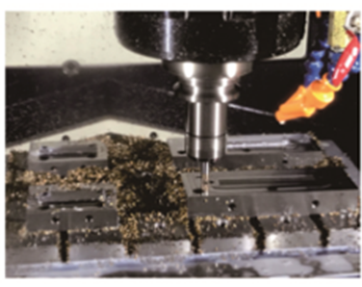
Successful Story - HSHFR - Germany
Machine: YASDA 640
Cutter: D8 High feed
Material: 1.2083 HRC52
Cutting：Z constant
Coolant: Air Blow
HSHFR 4080R0.75
Competitor F Company
Vc： 140 m/min
N: 5570 rpm
fz： 0,2mm/t
Vf: 4500mm/min
ap： 0,25mm
ae： 4,8mm
Vc： 140 m/min
N: 5570 rpm
fz： 0,18mm/t
Vf: 4000mm/min
ap： 0,18mm
ae： 4,8mm
Comment: both tools reached 3 hours tool life. But HSHFR realized 50% efficiency up.

Slide 16
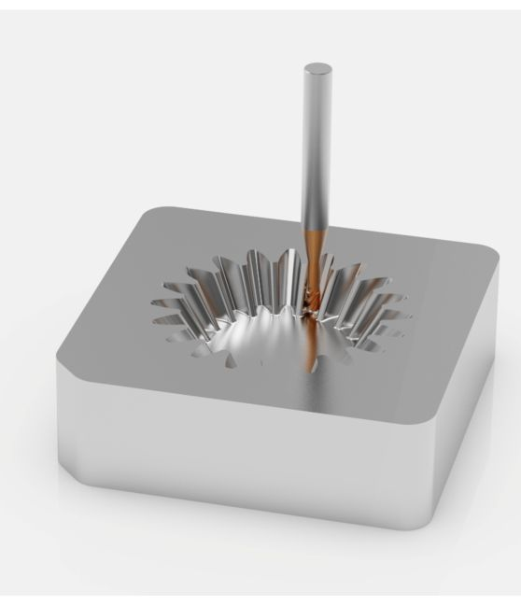

Successful Story – HSXRP - Italy
✅ Successful Test Report – HSXRP4080R1.0 (Ø8mm, R1mm corner radius)
We recently supported a customer in Italy who tested the HSXRP4080R1.0 under very demanding conditions:
Cutting speed (Vc): 60 m/min
Feed per tooth (fz): 0.08 mm/t
Depth of cut (ap): 0.2–0.25 mm
Width of cut (ae): 4 mm
Material: hardened steel 58–62 HRC
Despite the high hardness and long machining time, the tool delivered exceptional performance, running continuously for over 5 hours and still remaining in good condition for further use.
Due to workshop security policies, we couldn’t take photos, but both our partner and the end customer were very impressed with the results.

Slide 17
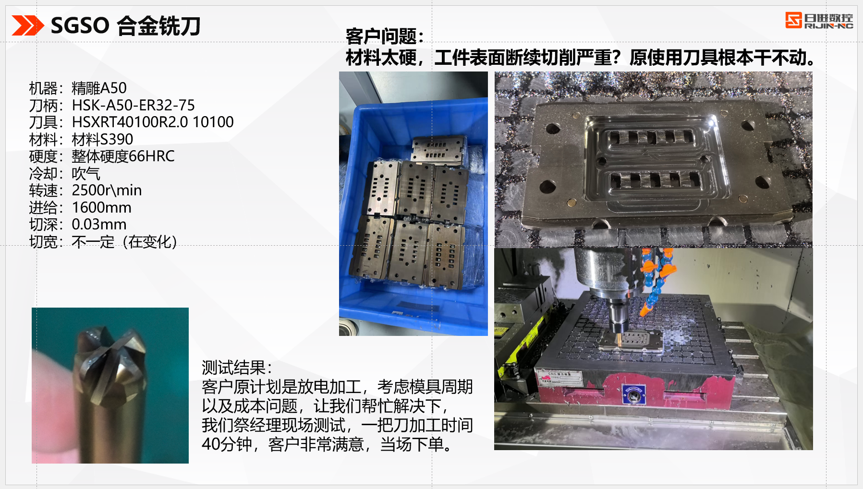
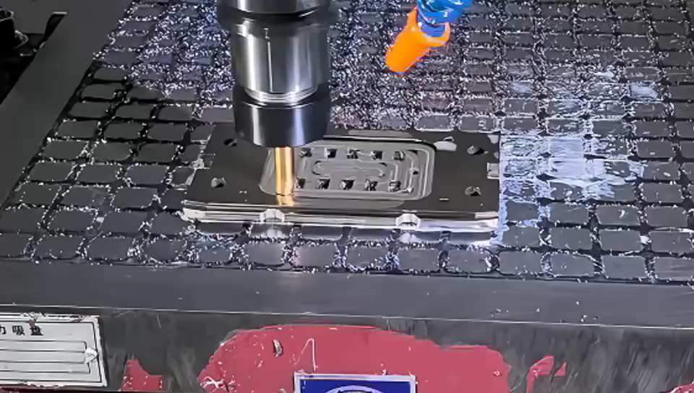

Successful Story – HSXRT
Machine: JINDIAO
Holder: HSK-A50-ER32-75
Cutter: D10xR2.0
Material: Böhler S390 – 66HRC
Cutting：Roughing
Machining time : 40min
Vc： 78.5 m/min
N: 2500rpm
fz： 0,33mm/t
Vf: 1600mm/min
ap： 0,03mm
ae： max 10mm
HSXRT4100R2.0 1075
After 40 minutes
Customer Comments:
Customer was very satisfied with HSXRT Performance in Hard Milling. Becuase they could remove the time-consuming EDM process.

Slide 18
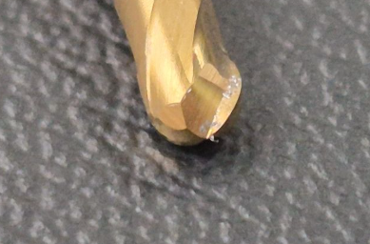
Successful Story – HSXB2 - Germany
Machine: Exeron HSC500
Holder: HSK40
Cutter: D3xR1.5
Material: ASP23/ 62HRC
Cutting：Finishing
Vc： 120 m/min
N: 12738 rpm
fz： 0,225mm/t
Vf: 2547mm/min
ap： 0,05mm
ae： 0,1mm
HSXB2030 0650
After 120 minutes

Slide 19
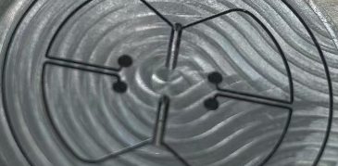

Successful Story – Ti-6-4- Neathland
Machine: Fanuc Robodrill (Max 24000)
Holder: BT40
Cutter: D0.3xR0.05
Material: Ti-6-4
Cutting：Slotting
Coolant
Width 0.3mm
Depth 1.85mm
HSXR2003R0.05L1 0450
HSXR2003R0.05L2 0450
Vc： 23 m/min
N: 24000 rpm
fz： 0,002mm/t
Vf: 96mm/min
ap： 0,05mm
ae： 0,3mm
Depth to 1mm
Vc： 23 m/min
N: 24000 rpm
fz： 0,002mm/t
Vf: 96mm/min
ap： 0,03mm
ae： 0,3mm
Depth to 1.85mm
Customer Comments:
Amazingly long tool life, is double tool life that of the best tools up to now, which is special items with underneck 1.85mm

Slide 20
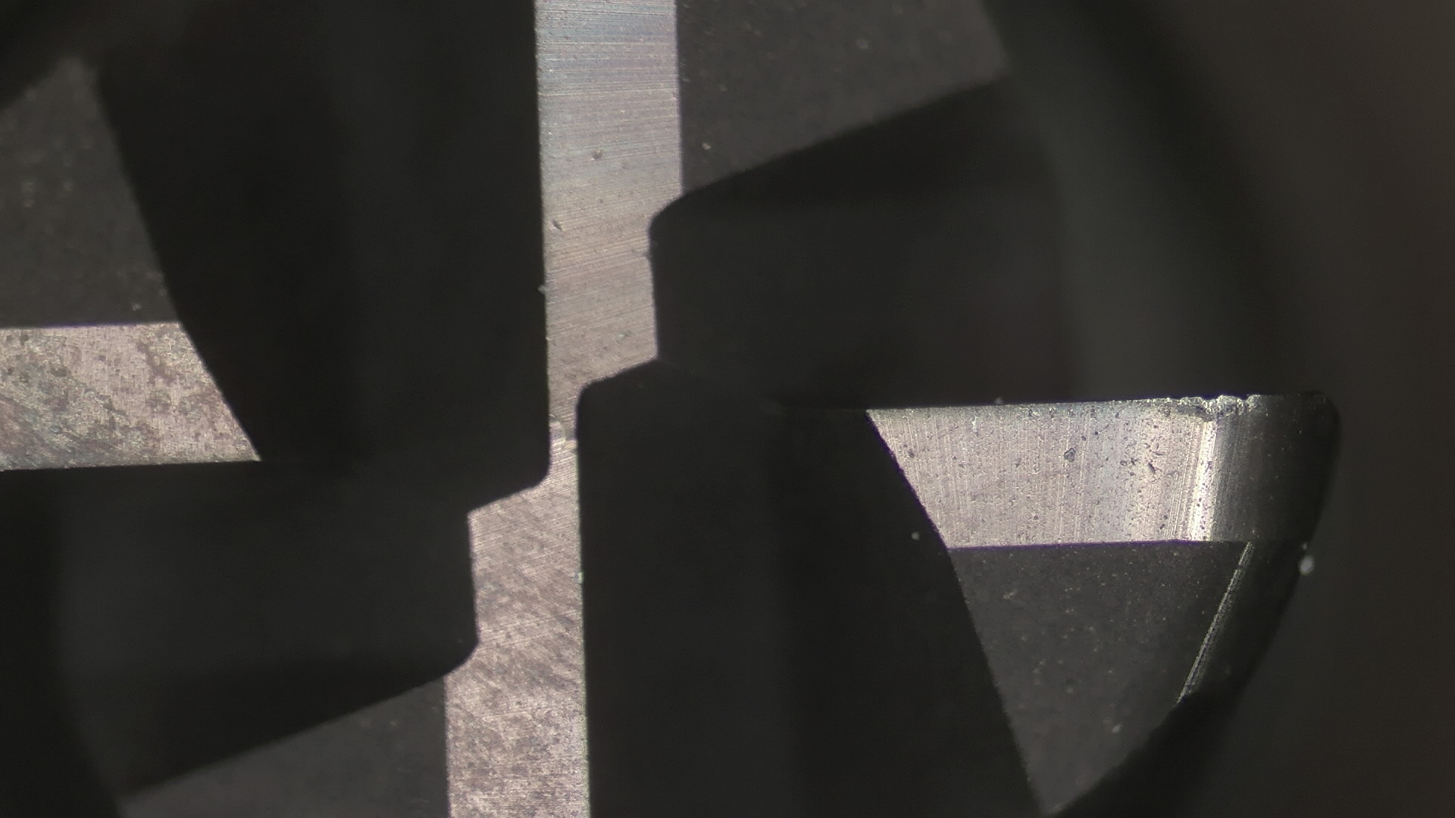



Successful Story – HSXR4
Machine: HSK-A63
Cutter: D10xR0.5
Material: 1.2083 - 50HRC
Cutting：Roughing
Machining time : up to tool life
Vc： 113 m/min
N: 6000 rpm
fz： 0,04mm/t
Vf: 1000mm/min
ap： 0,03mm
ae： 3mm
H Company
J Company
U Company
HSXR4060R0.5 0660
After 180 min
After 100 min
After 60 min
After 40 min

Slide 21



Successful Story – HSXRT4
Machine: MAKINO V56
Spindle: BT40
Cutter: D6xR1.0
Material: 1.2343 - 52HRC
Cutting：Roughing
Coolant : Airblow
Vc： 75 m/min
N: 4000 rpm
fz： 0,138mm/t
Vf: 2200mm/min
ap： 0,2mm
ae： Max 6mm
HSXRT4060R1.0 0660
Customer Comments:
Previous end mill from competitors could finish 4 parts. But HSXRT achieved 6 parts in 8 hours with still small wear

Slide 22


Demo Röders
1.2343 50-52HRC
HSXRP4030 0650
Semi-finishing

Slide 23


Demo Röders

Slide 24


