Slide 1
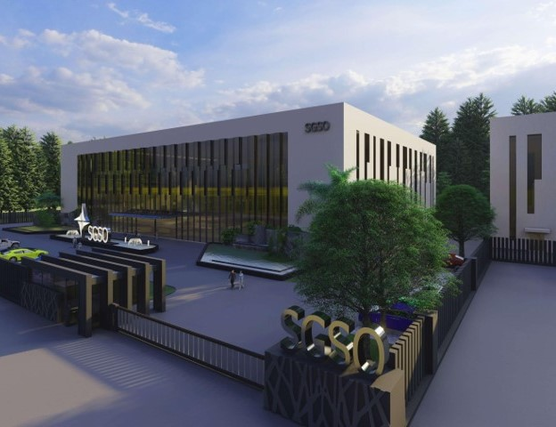

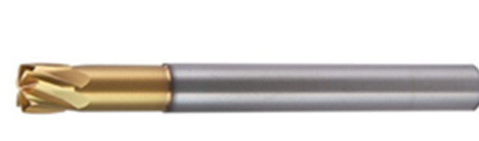
SGSO Technology
HSXHR
High Feed for High Hardness
Notes:
Sustained Growth Smart Optimization

Slide 2
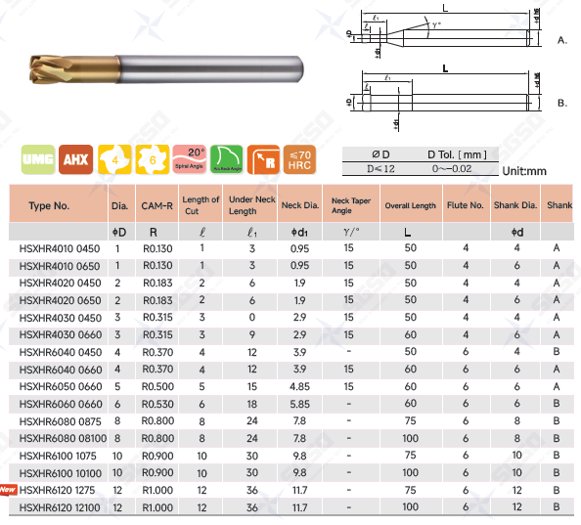
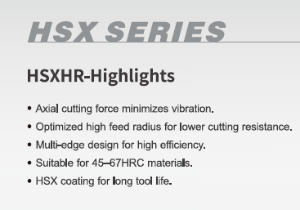
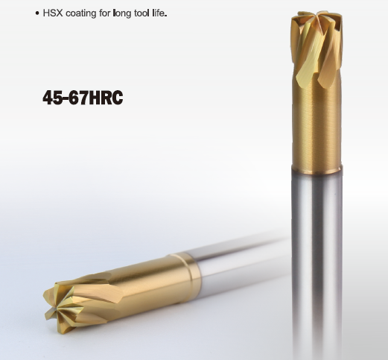
HSXHR Features

Slide 3
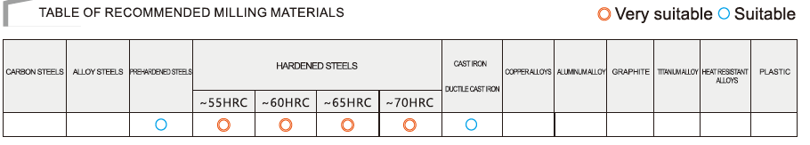
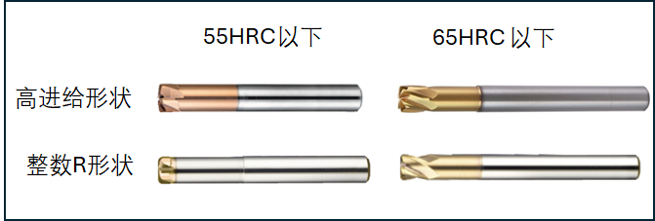
HSXHR Material
Material < 55 HRC
55HRC<Material< 70 HRC
High Feed Geometry
HSHFR
HSXHR
Real Radius Geometry
HSXRP
HSXRT

Slide 4
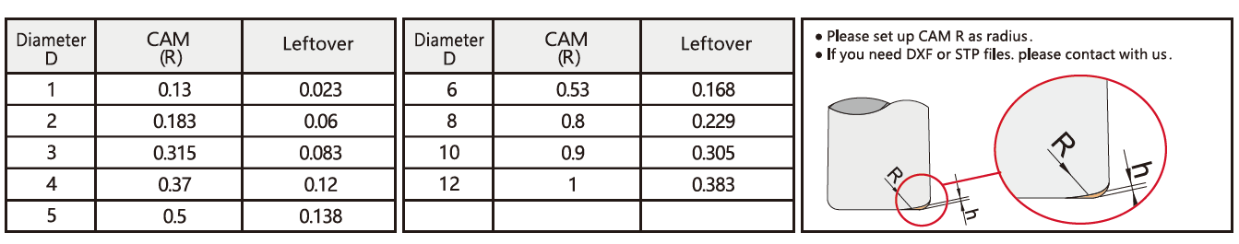
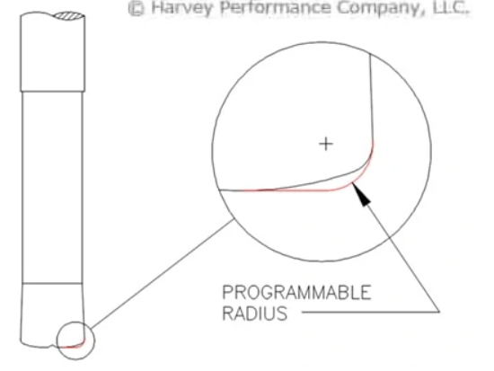
High Feed R and Leftover
h
h

Slide 5
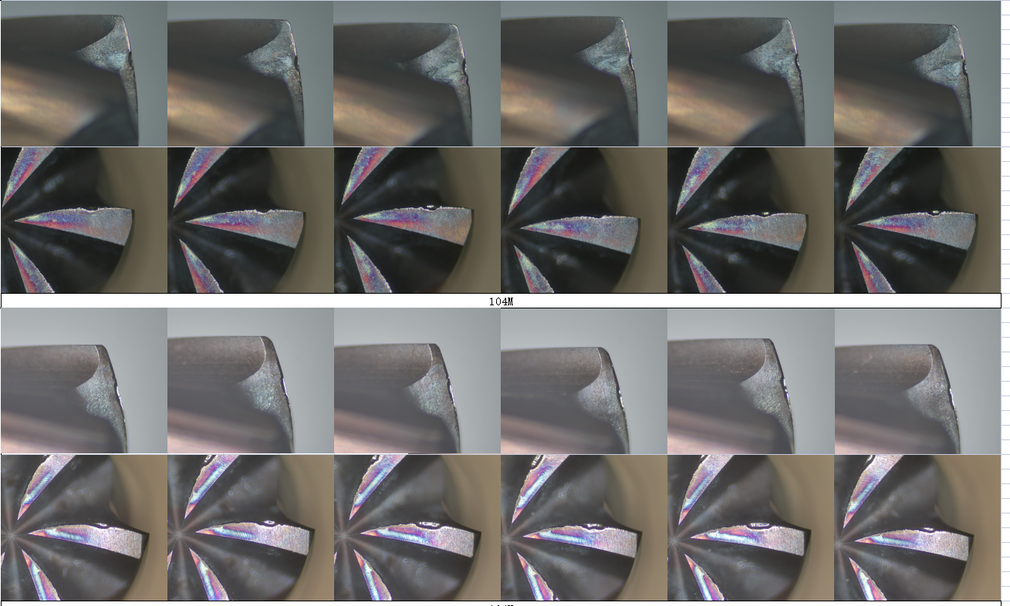
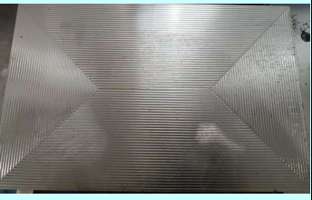
HSXHR Test
SGSO (120min)
Machine：HSK A63
Cutter： D6x6t High feed
Material：1.2379 62HRC
Cutting： flat face milling
Coolant： Airblow
Vc： 70 m/min
n： 3730 rpm
fz： 0,15mm/t
Vf： 3350mm/min
ap： 0,13mm
ae： 4,2mm (70%Dia.)
Competitor (120min)

Slide 6
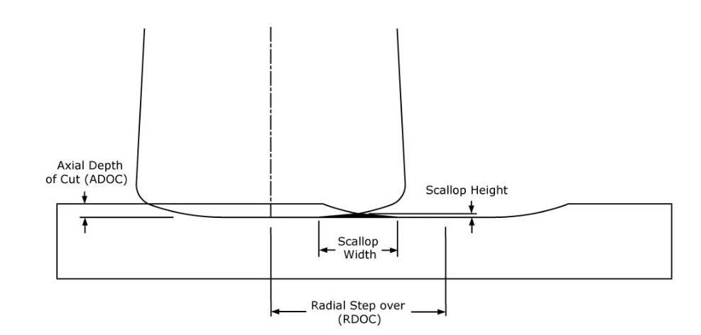
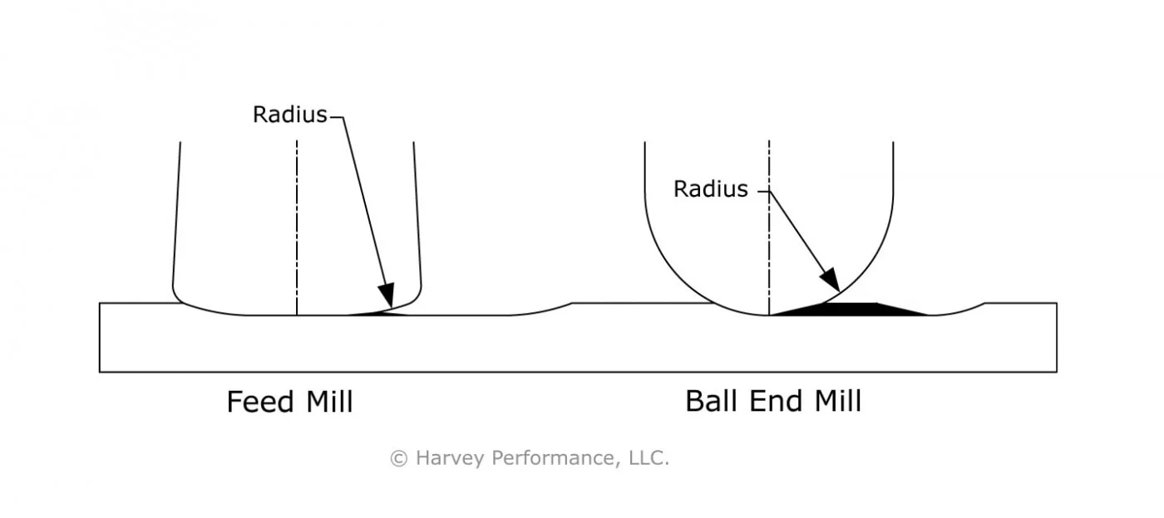
HSXHR Application – Flat face finishing
In some case you can use HSXHR with small ae for mirror finishing of flat face.
Because big Radius leave less material on the surface than ball nose.

Slide 7
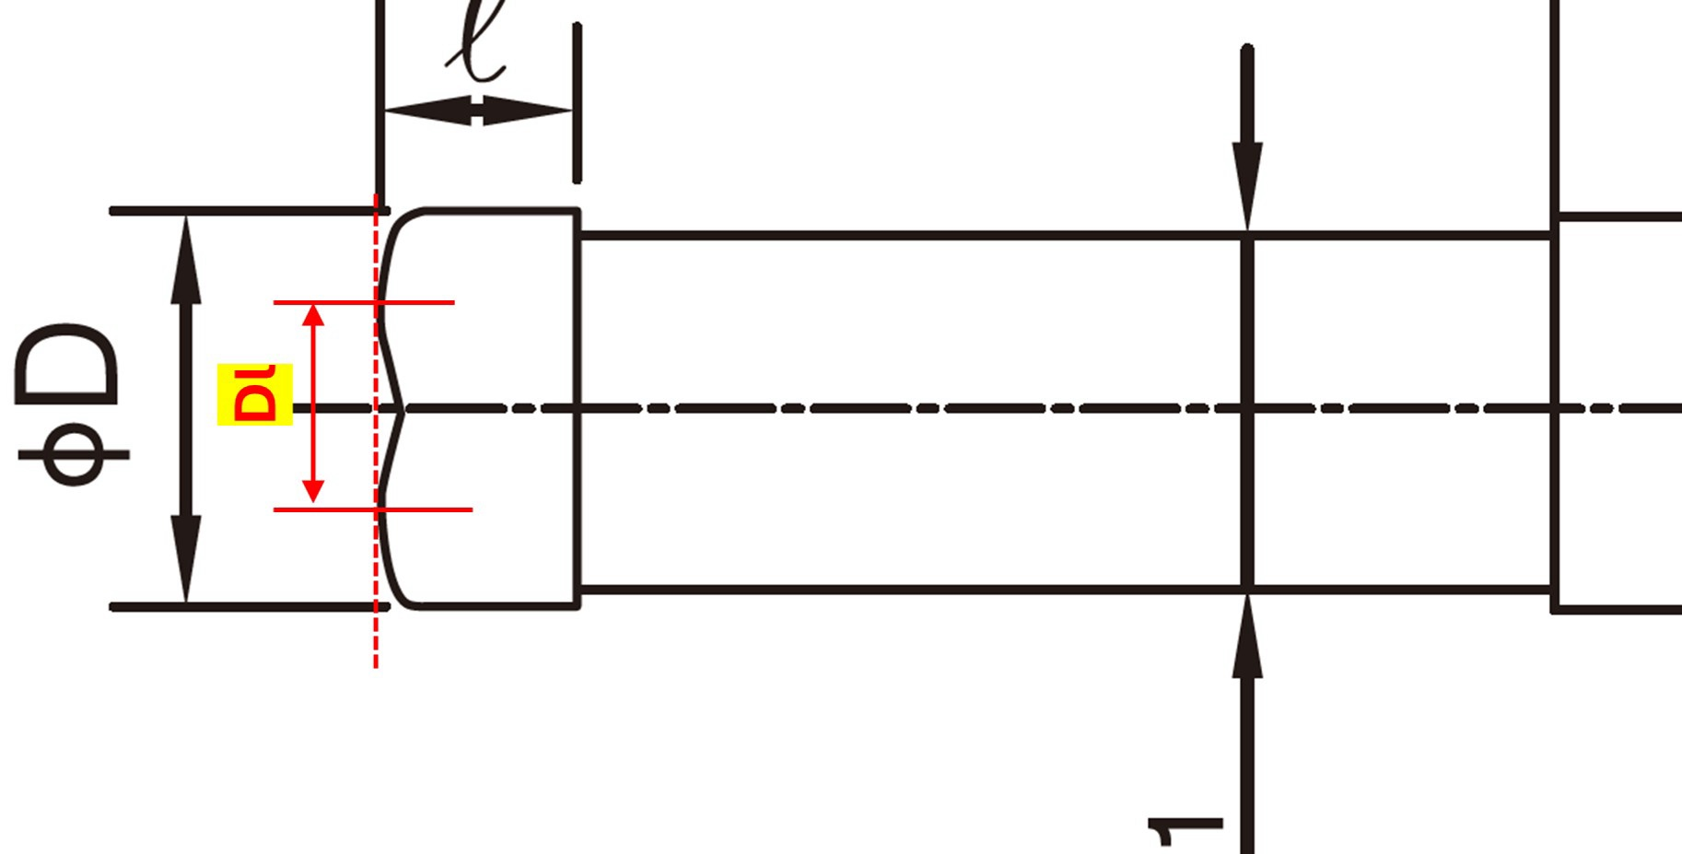

Slide 8


