Slide 1



SGSO Technology
HSXDT Thread Mill
Notes:
Sustained Growth Smart Optimization

Slide 2
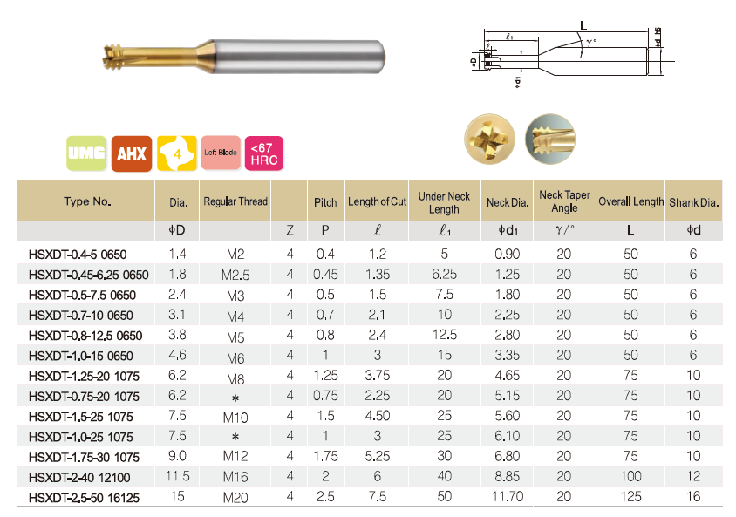
HSXDT Line up
Possible to open threads
WITHOUT pre-holes (drill)

Slide 3
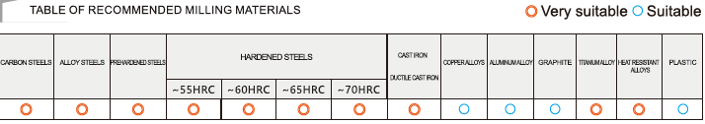
Material
Mold making
Parts making
Strong advantage in difficult-machining material
Hardened steel
Super alloy
Pre-hardened steel
Stainless steel
Also possible for soft material threading
Copper
Aluminium

Slide 4
Predicted Tool Life
Cutting Material | With pre-hole | Without pre-hole
63 - 70HRC（1.3344 etc） | 50 threads | 40 threads
56 - 62HRC（1.2379 etc） | 80 threads | 60threads
51 - 55HRC（1.2343. 1,2083 etc） | 200threads | 150threads
40 - 50HRC（1.2343 etc） | 350threads | 250threads
Pre-hardened steel （1.2311 etc） | 700threads | 600threads
Carbon steel etc | 350threads | 250threads
Cast iron | 700threads | 600threads
Stainless and Ti alloy | 1000threads | 800threads
Super alloy (Inconel) | 40threads | 30threads
This above result is only for reference. The result depends on different machining situation
Normally we suggest with pre-hole for longer tool life and higher efficiency

Slide 5
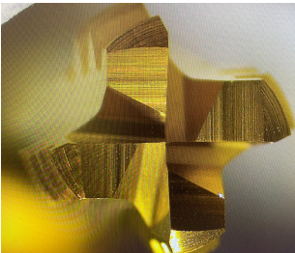
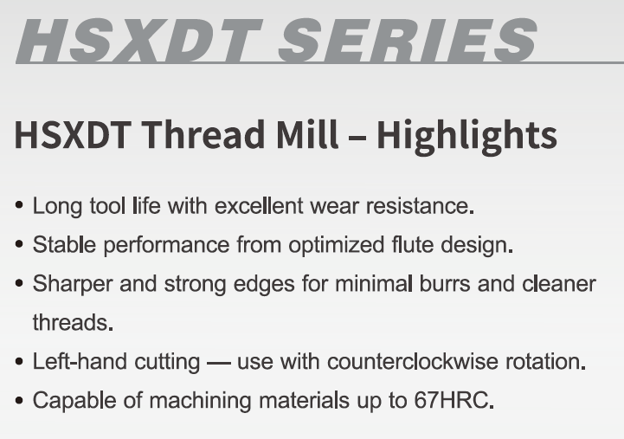
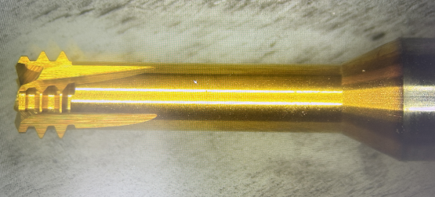
HSXDT Features
Bigger chip pocket

Slide 6
HSXDT Program
Spindle rotates counter-clockwise!!
A
B
C
D
E
F
* Heidenhain processor Cycle 265
* Siemens processor Cycle 90
Process E is needed for safe withdraw of tread mill

Slide 7
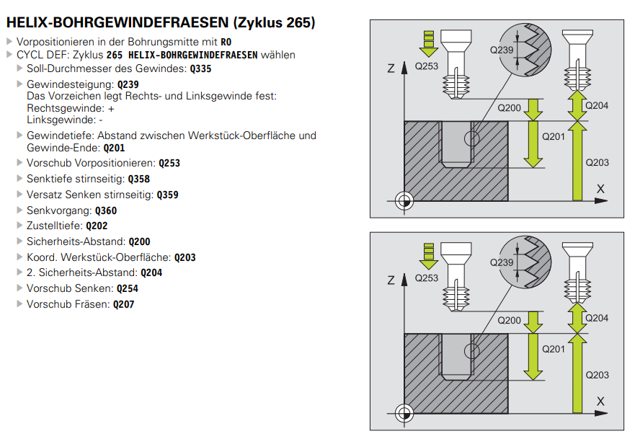
Program

Slide 8
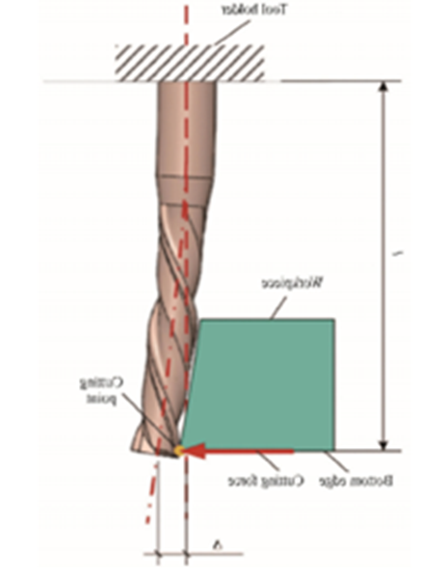
HSXDT Compensation
HSXDT
HSXDT
a
Theoritical thread size
Real thead size
a will be caused by deflection or wear of tread mill, and finally produce a smaller thread than theoretical size.
In some cases, need compensation or air cut to reach the requested thread size.

Slide 9
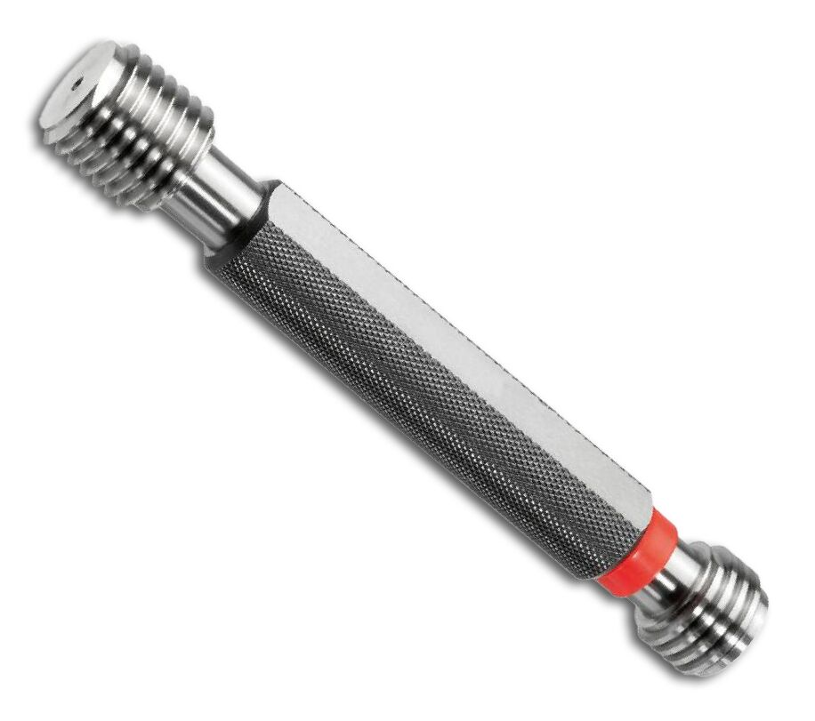
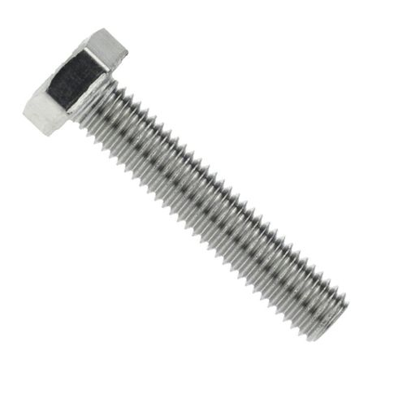
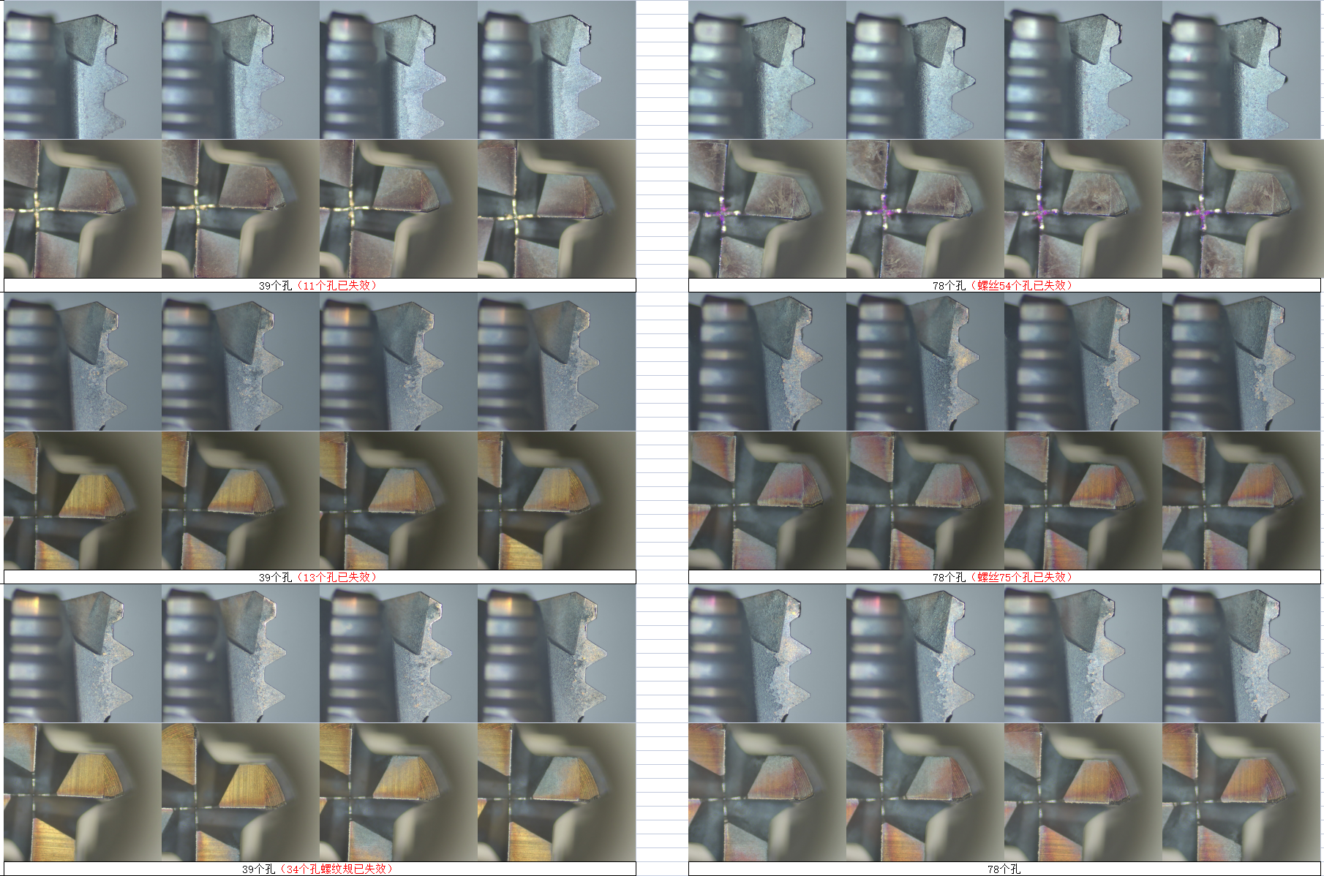
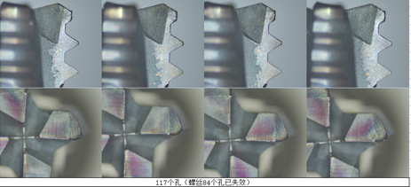
Test Result
Measure with
Thread Gauge
Measure with
Screw
Machine：HSK A63
Thread： M6
Material：1.2379 62HRC
Coolant： Airblow
Competitor
Compensation
-0,006mm
11 OK of 39 theads
54 OK of 78 threads
Vc： 40 m/min
n： 2800 rpm
fz： 0,007mm/t
Vf： 78mm/min
SGSO
Compensation
-0,006mm
13 Ok of 39 threads
75 OK of 78 threads
SGSO
Compensation
-0,007mm
34 OK of 39 threads
78 OK of 78 threads
84 OK of 117 threads
Notes:
Competitor is Moldino EDT

Slide 10
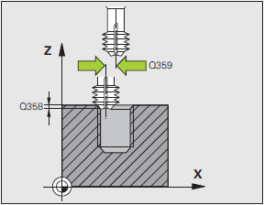
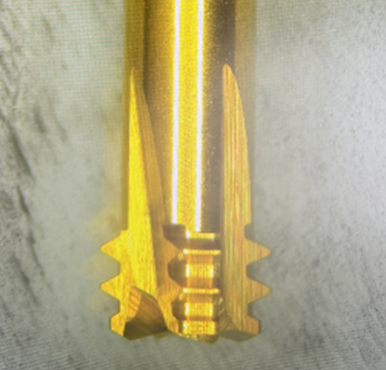
Chamfer of Thread
HSXDT is possible to cut chamfer of thead with end cutting edges.
However, We will alwasy suggest using other tools for chamfer milling,
To have better tool life of HSXDT, for example ball nose tools HSXB2.
Chamfer example in Heidenhain Cricle 265
Q358: depth of chamfer
Q359: position of chamfer
Example
HSXDT Dia. 3.1mm,
Thread M4 has Dia. 4mm,
Chamfer width 0.3mm,
Q359=2-1.55+0.3=0.75mm)
Q360: chamfer before or after thread
fullin 0 is to chamfer before thread
fullin 1 is to chamfer after thread
we recommend chamfer after thread milling, especially in the case of hard
material. In the case of soft material.
Cutting edges possible for chamfer

Slide 11

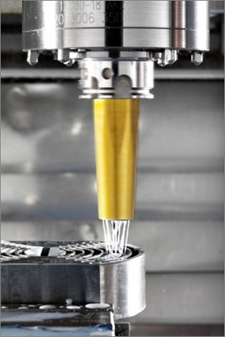
Cooling and chip evacuation
holder
holder
Chip Evacuation is most important factor
In the case of Hardened Steel
If air blow is strong enough to remove the chips, then airblow is best recommendation because of longer tool life.
If air blow is not enough to evacuate the chips, then please use emulsion cooling.
In the case of Stainless Steel, Ti alloy, Inconel etc
- Please always use emulsion cooling.

Slide 12


Slide 13


Slide 14
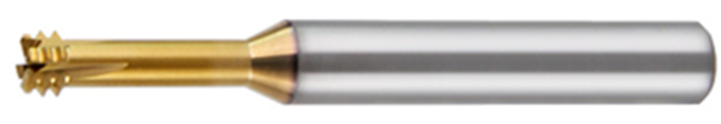
Hard Threading
General application of direct hard threading
Fixing threads of stamping die and pressing die
(hardened tool steel and high speed steel and powder steel)
2. Plastic mold cooling hole threads
(hardened tool steel and some softer tool steel)
Some reasons of direct hard threading
Modification (for example M4 to M6 )
Repair (smaller to bigger)
Forget
Fast delivery
Current methods that users are using
EDM (Electronic Discharge Machining)
Drill+Tap
Drill+thread mill
Thread mill from competitor

