Slide 1
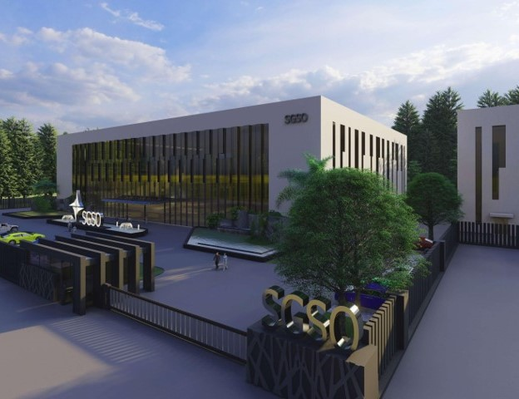

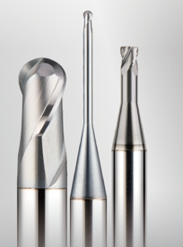
SGSO Technology
HGX Series
Notes:
Sustained Growth Smart Optimization

Slide 2
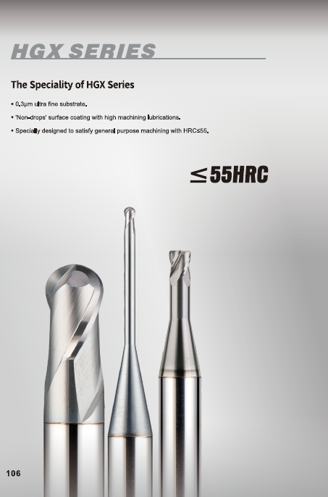
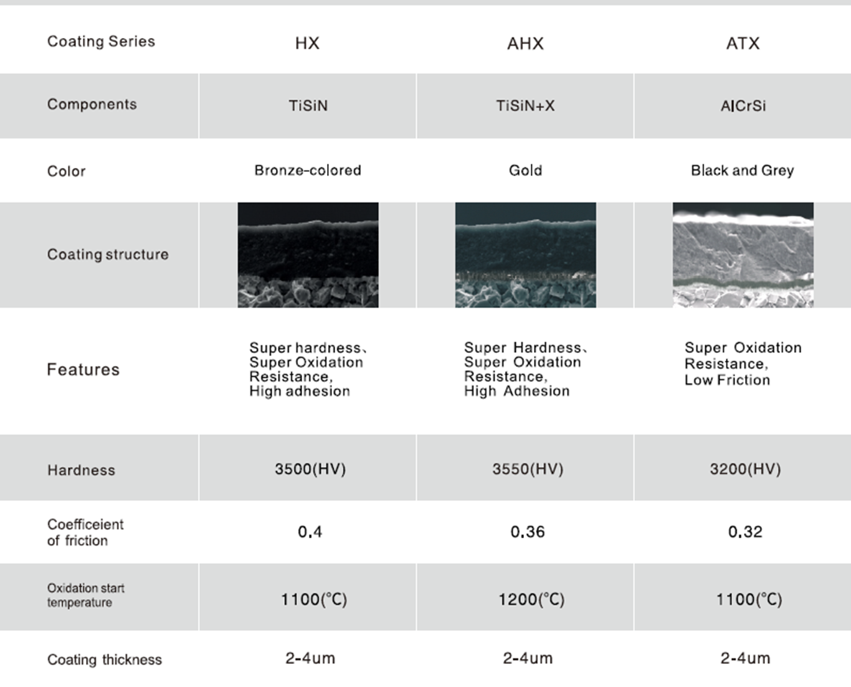
HGX (ATX coating - Nano Multiple layer structure)

Slide 3
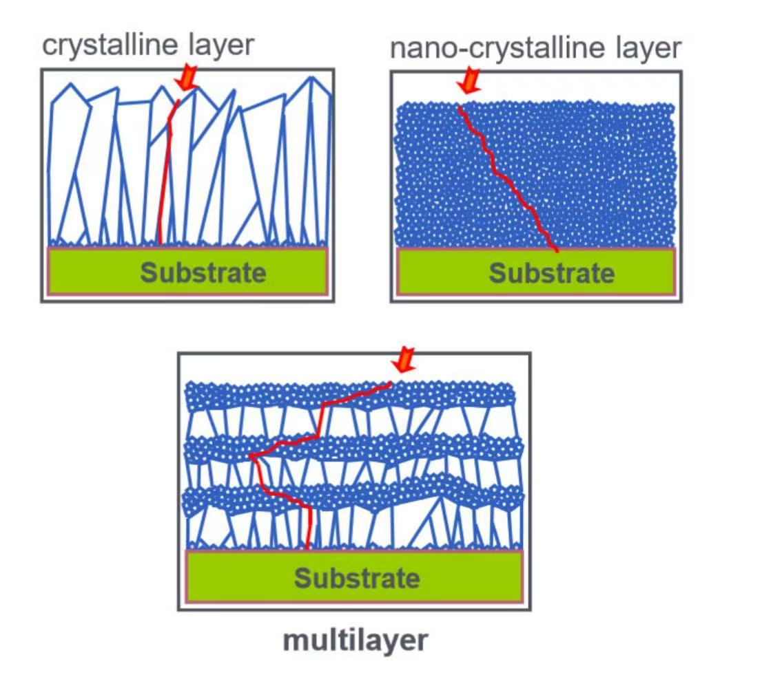
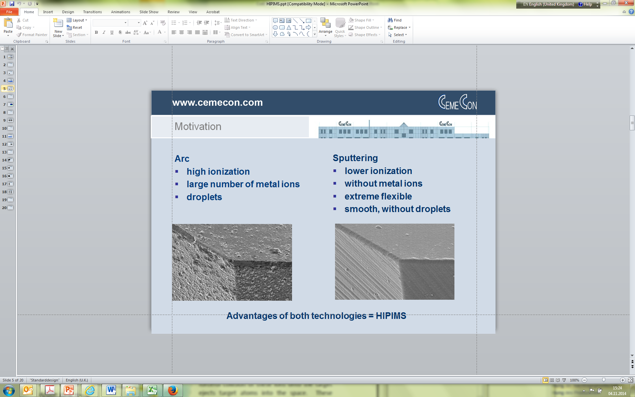
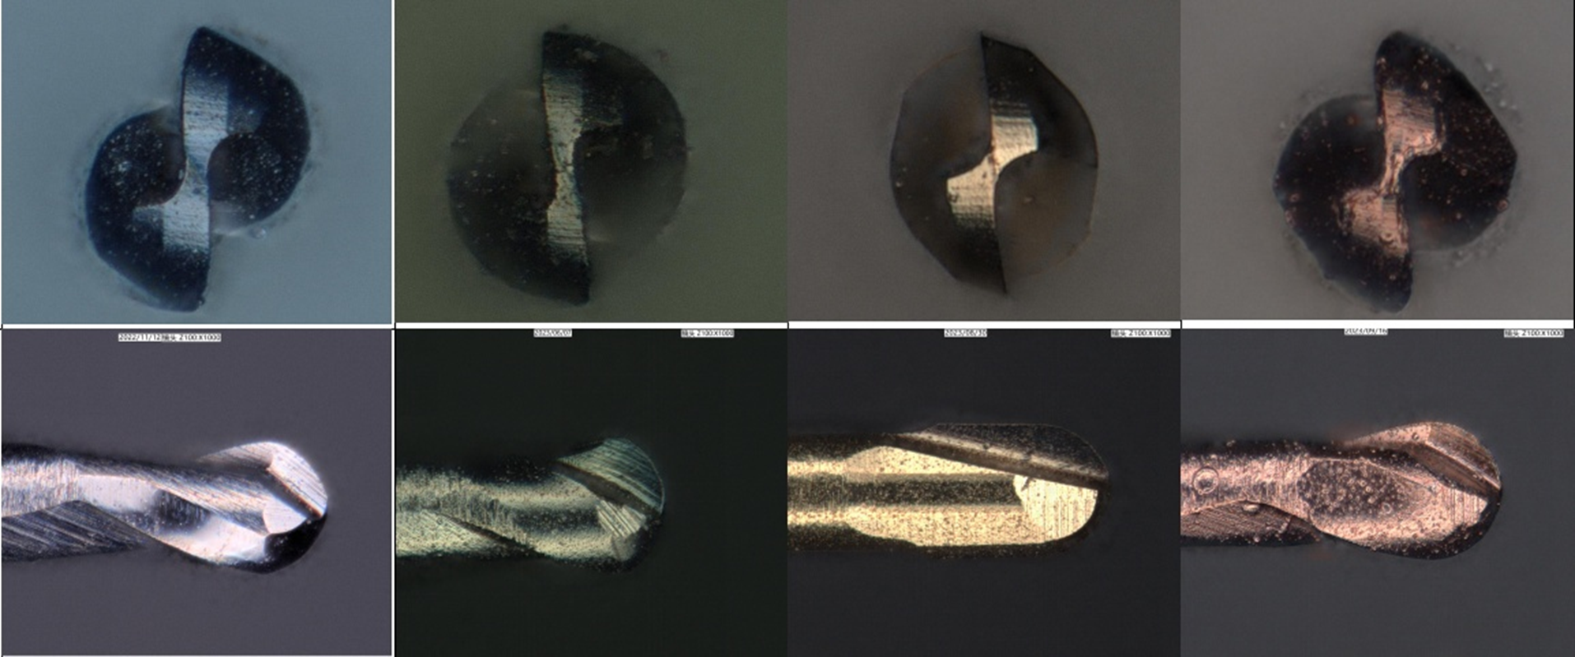

HSX/HGX coating- Nano Coating
Nano Multiple layer coating
Competitor

Slide 4

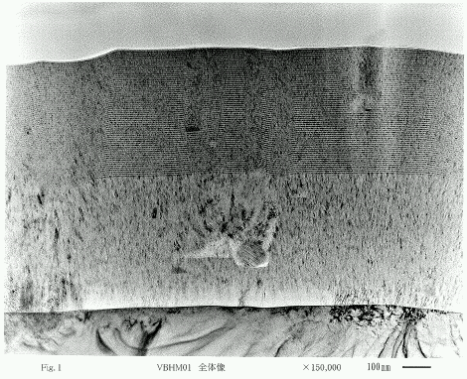
HSX/HGX coating- Multiple layer Coating
Single Layer
Multi-Layer

Slide 5
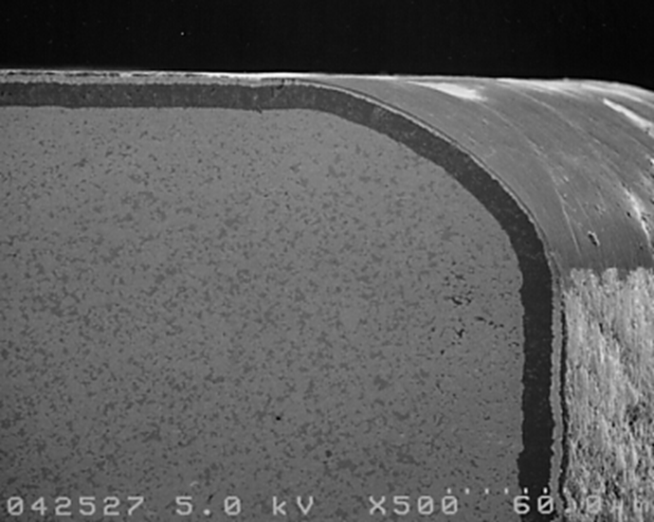
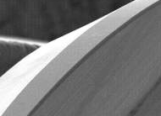
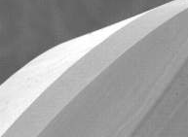


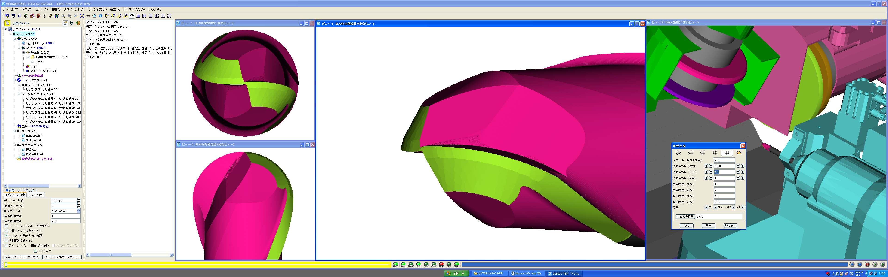

Edge Treatment
Cutting edge
with treatment
Cutting edge without treatment
Relief face
Rake face
Tougher cutting edges
Sharper cutting edges

Slide 6
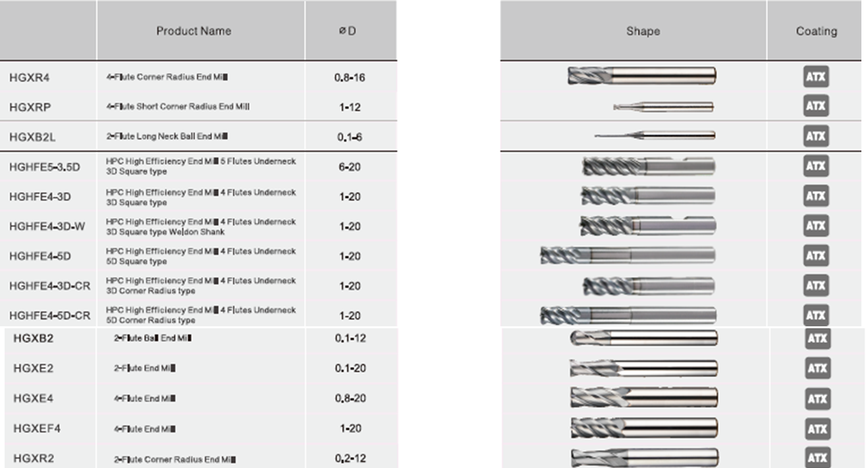
HGX Overview

Slide 7
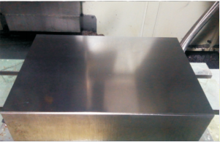

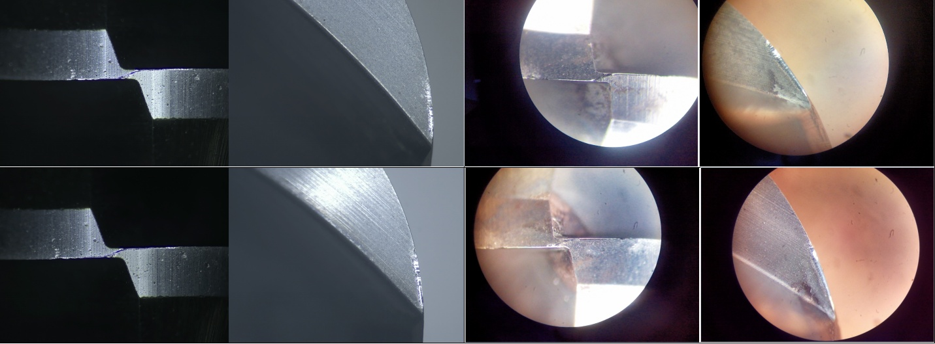
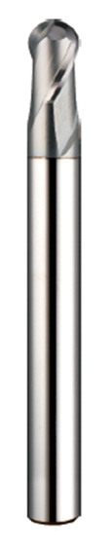
Successful Story – HGXB2- Internal Test
Machine：HSK A63 spindle
Cutter： R4x2t Ball nose
Material：1.2312 33HRC
Cutting： flat face finishing
Coolant： Emulsion
Vc： 200 m/min
n： 8000 rpm
fz： 0,187mm/t
Vf： 3000mm/min
ap： 0,08mm
ae： 0,2mm
H company
HGXB20800875
After
6 hours
After
9 hours

Slide 8

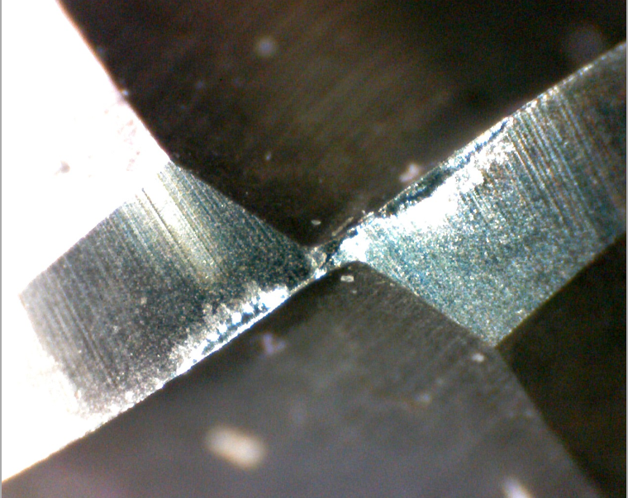
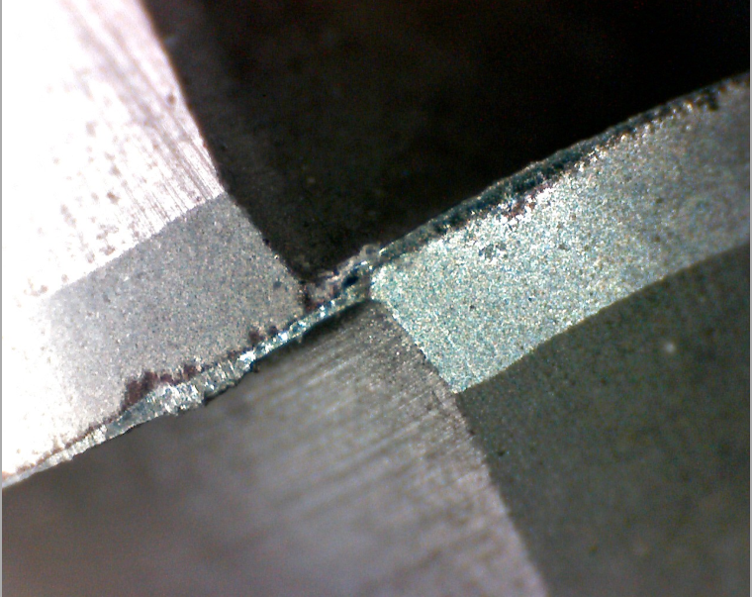
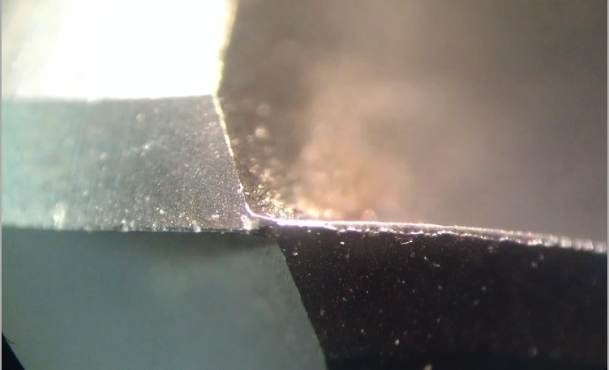
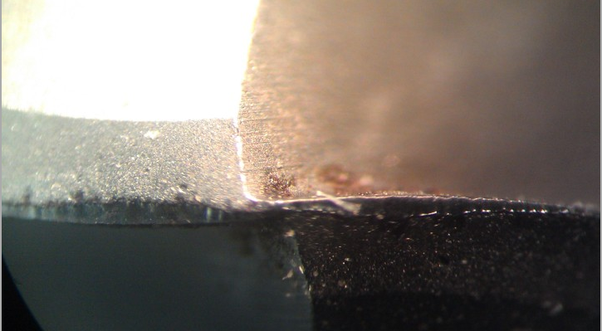

Successful Story – HGXB2 – Internal Test
Vc： 200 m/min
n： 8000
fz： 0,188mm/t
Vf： 3000mm/min
ap： 0,05mm
ae： 0,2mm
Machine: QJM AV612
Cutter: R4 Ball nose
Material: 1.2311 33HRC
Cutting：3D finishing
Coolant: Emulsion
Vc： 214 m/min
n： 8500
fz： 0,2mm/t
Vf： 3500mm/min
ap： 0,08mm
ae： 0,15mm
Machine: QJM AV612
Cutter: R4 Ball nose
Material: 1.2311 33HRC
Cutting：3D finishing
Coolant: Emulsion
H Competitor
H Competitor
HGXB 2080 0874
HGXB2080 0875
After 14h
After 10h36min

Slide 9
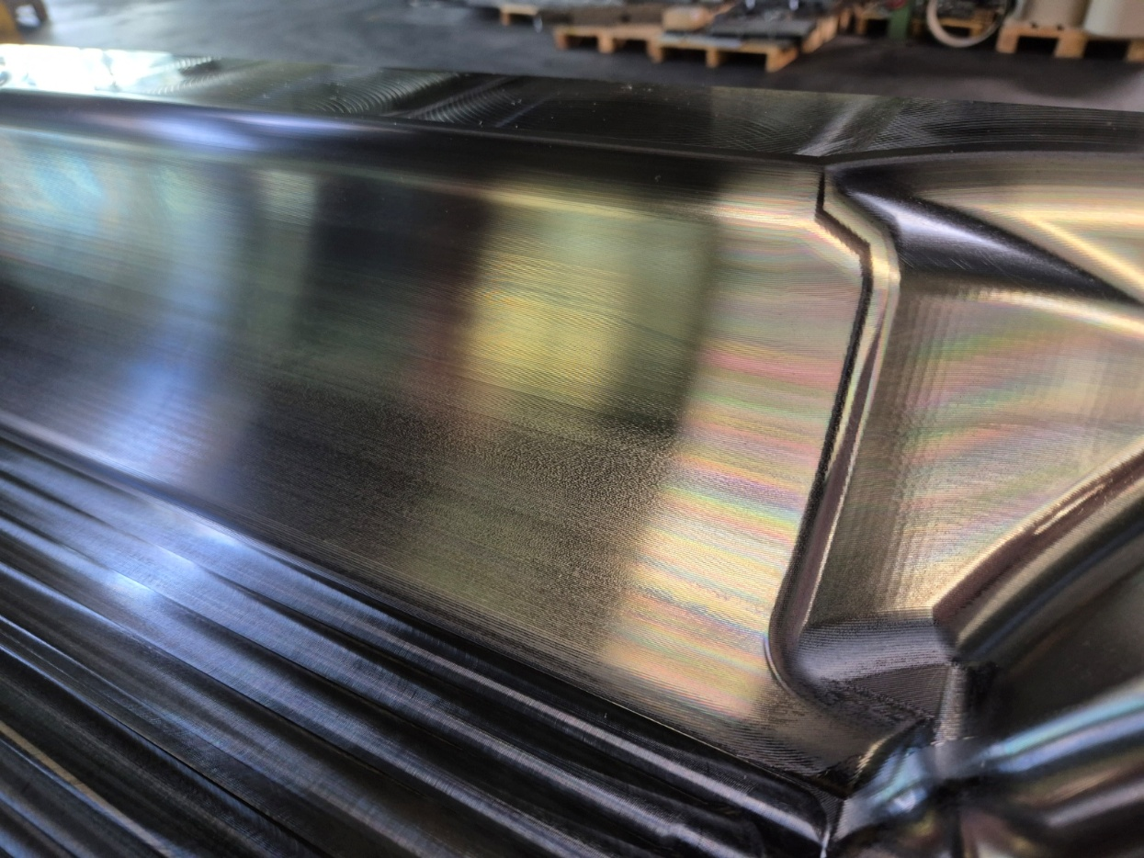
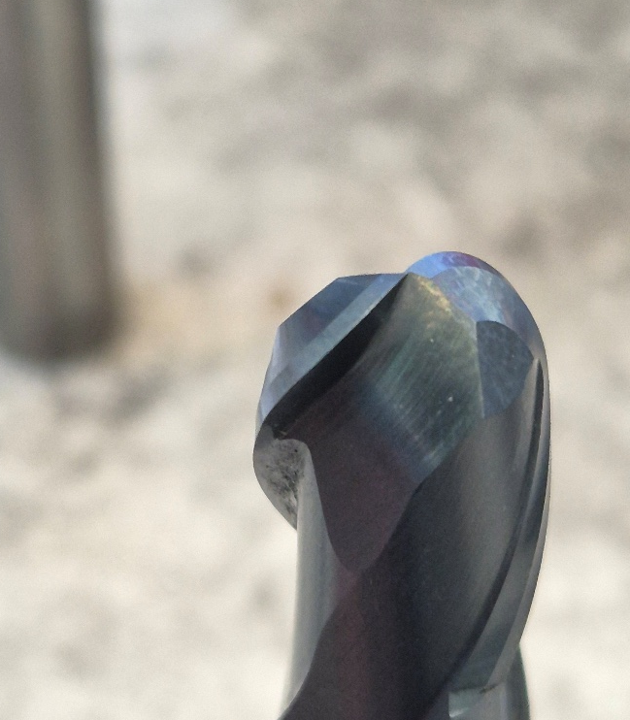
Successful Story – HGXB2 - Germany
Machine: HSK A63
Cutter: R6 Ball nose
Material: 1.2714 46HRC
Cutting：3D finishing
Coolant: Emulsion
Vc： 250 m/min
N: 6634rpm
fz： 0,11mm/t
Vf : 1500mm/min
ap： 0,36mm
ae： 0,36mm
HGXB2120
575min
Kunden Kommentar
Very shining surface and even after 10 hours milling,
There was almost no obvious wear.

Slide 10

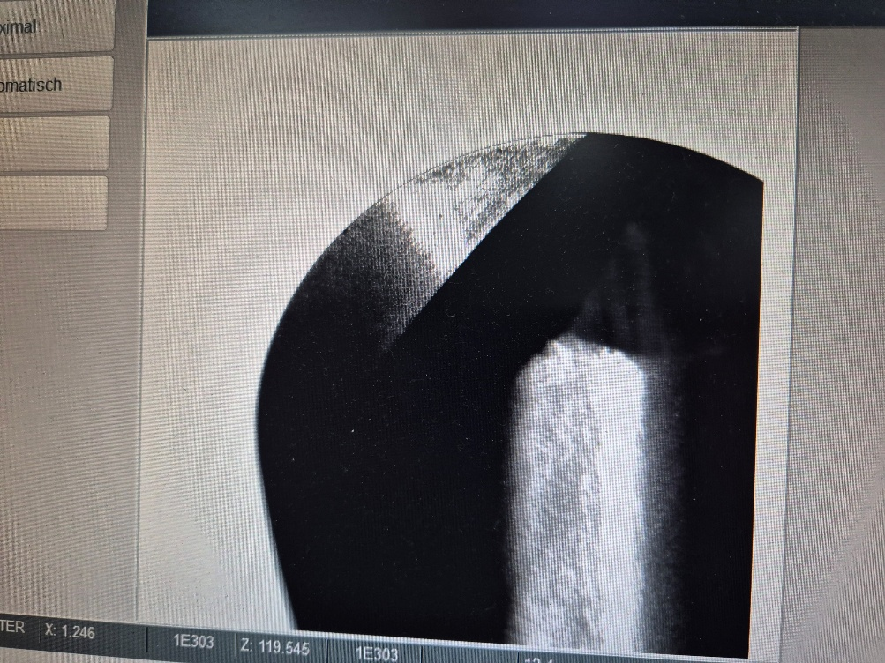
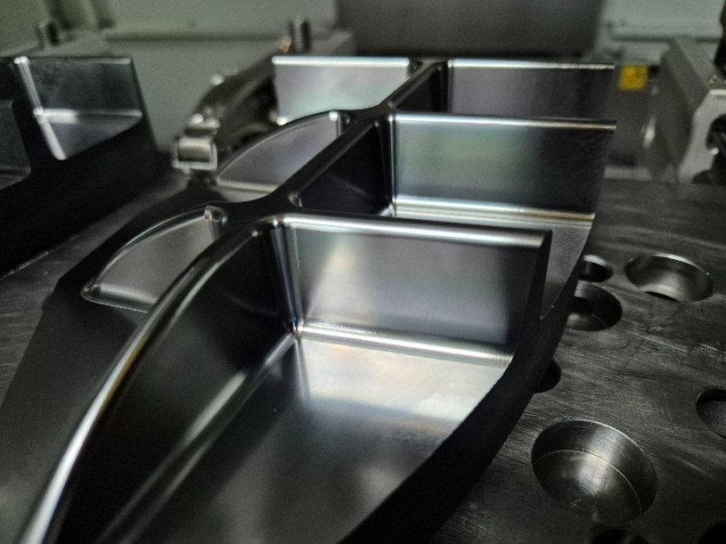
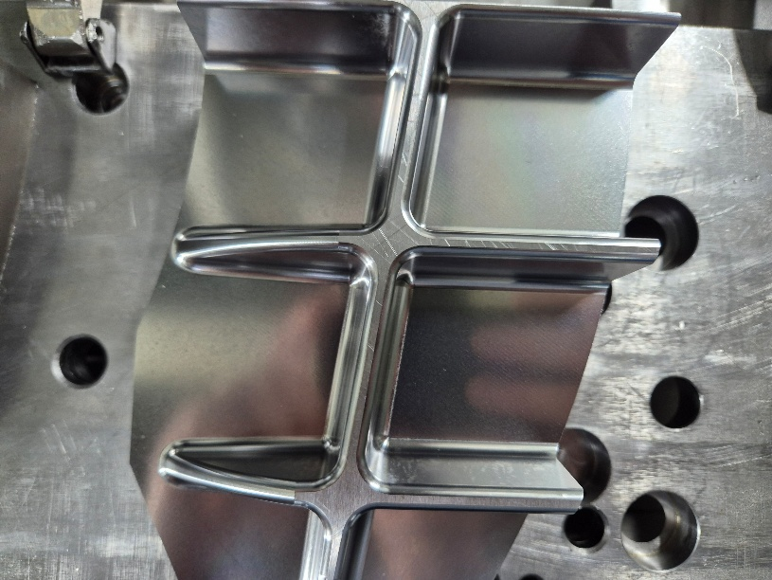
Successful Story - HGXB2 - Germany
HGXB2060 0660
420min
Machine: MT CUT
Cutter: R3 Ball nose
Material: 1.2312
Cutting：Z constant finishing
Vc： 250 m/min
N: 13269rpm
fz： 0,07mm/t
Vf: 1857mm/min
ap： 0,1mm
ae： 0,15mm
Kunden Kommentar
Long tool life and excellent finishing quality

Slide 11
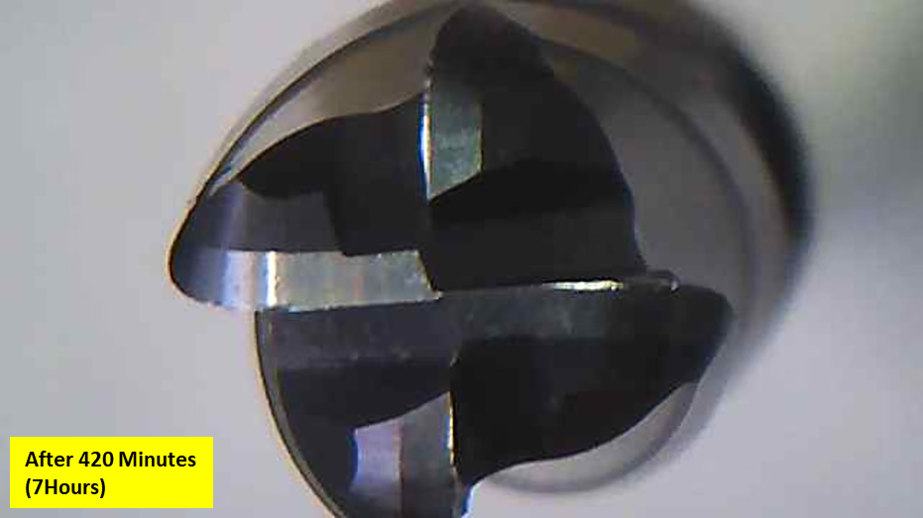

Successful Story – HGXR4 - Germany
Machine：DMC 635V (HSK63)
Cutter： D8xR2 Radius endmill
Material：1,2379 40HRC
Cutting： Finishing
Coolant： Emulsion
M Company
Customer Comments:
Even after 7 hours finishing application,
Still very sharp and more than twice tool life of current competitor.
This end mill is multiple tasking, not only
Z constant milling and side milling, slotting.
HGXR4080R2,0 0875

Slide 12
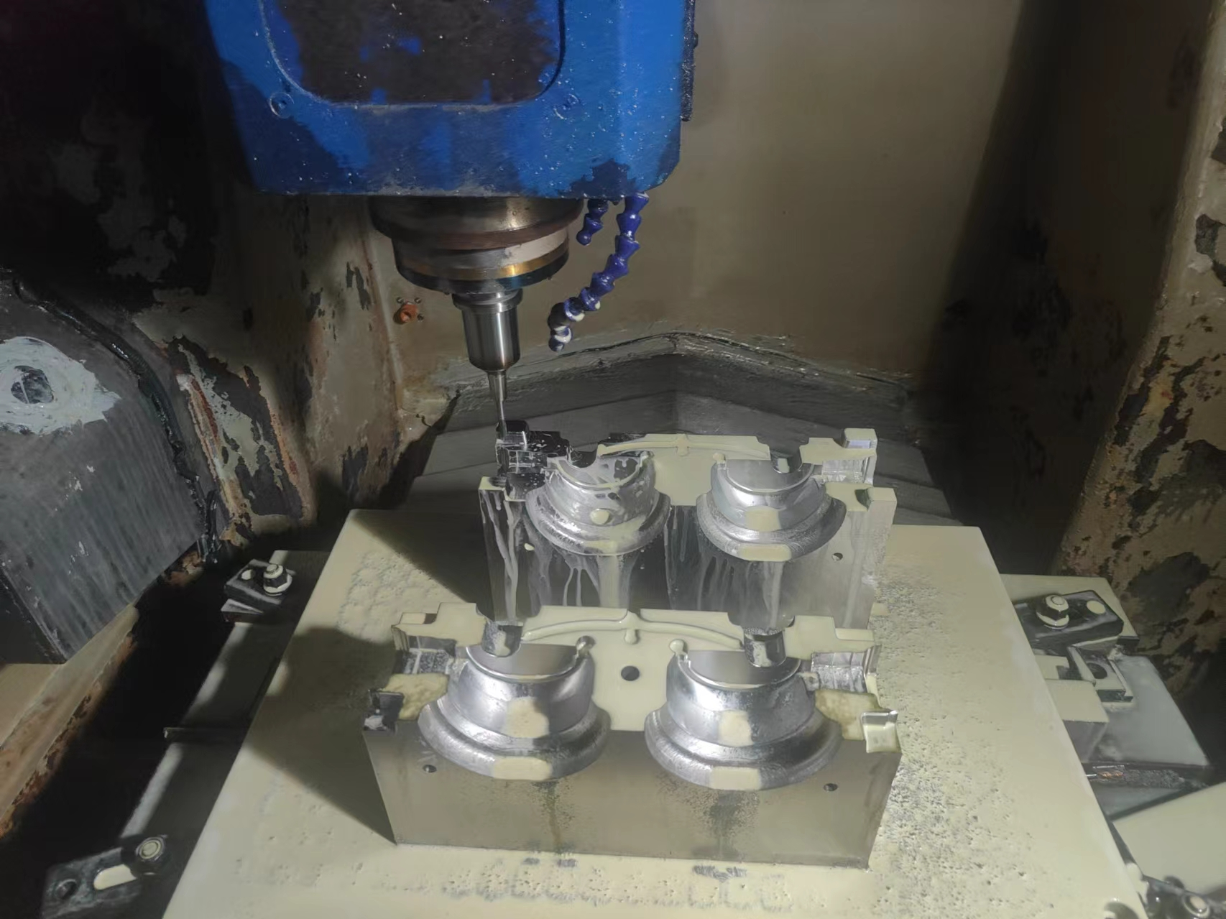
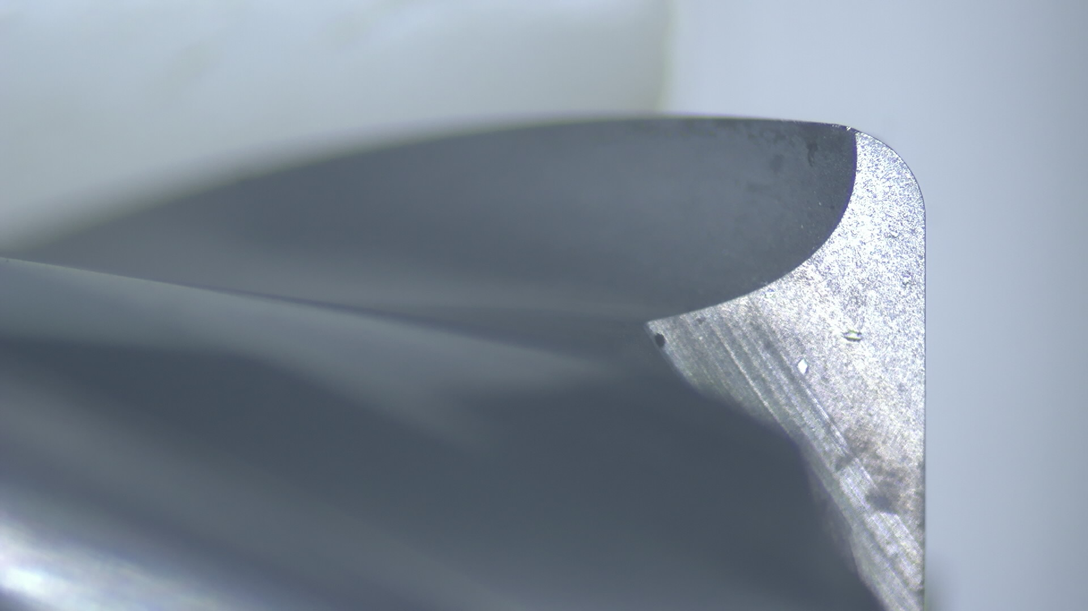
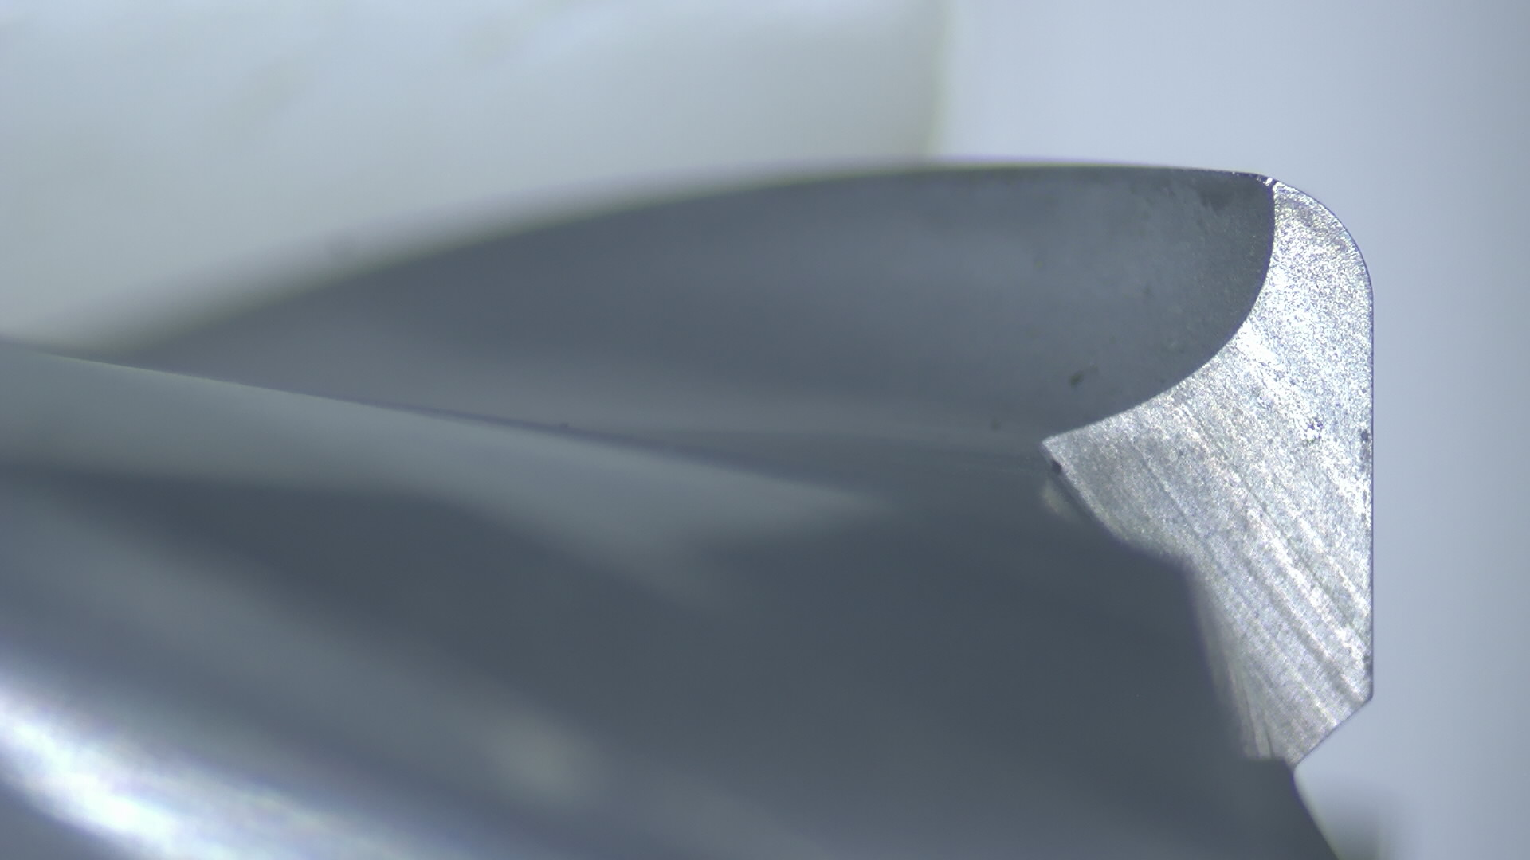
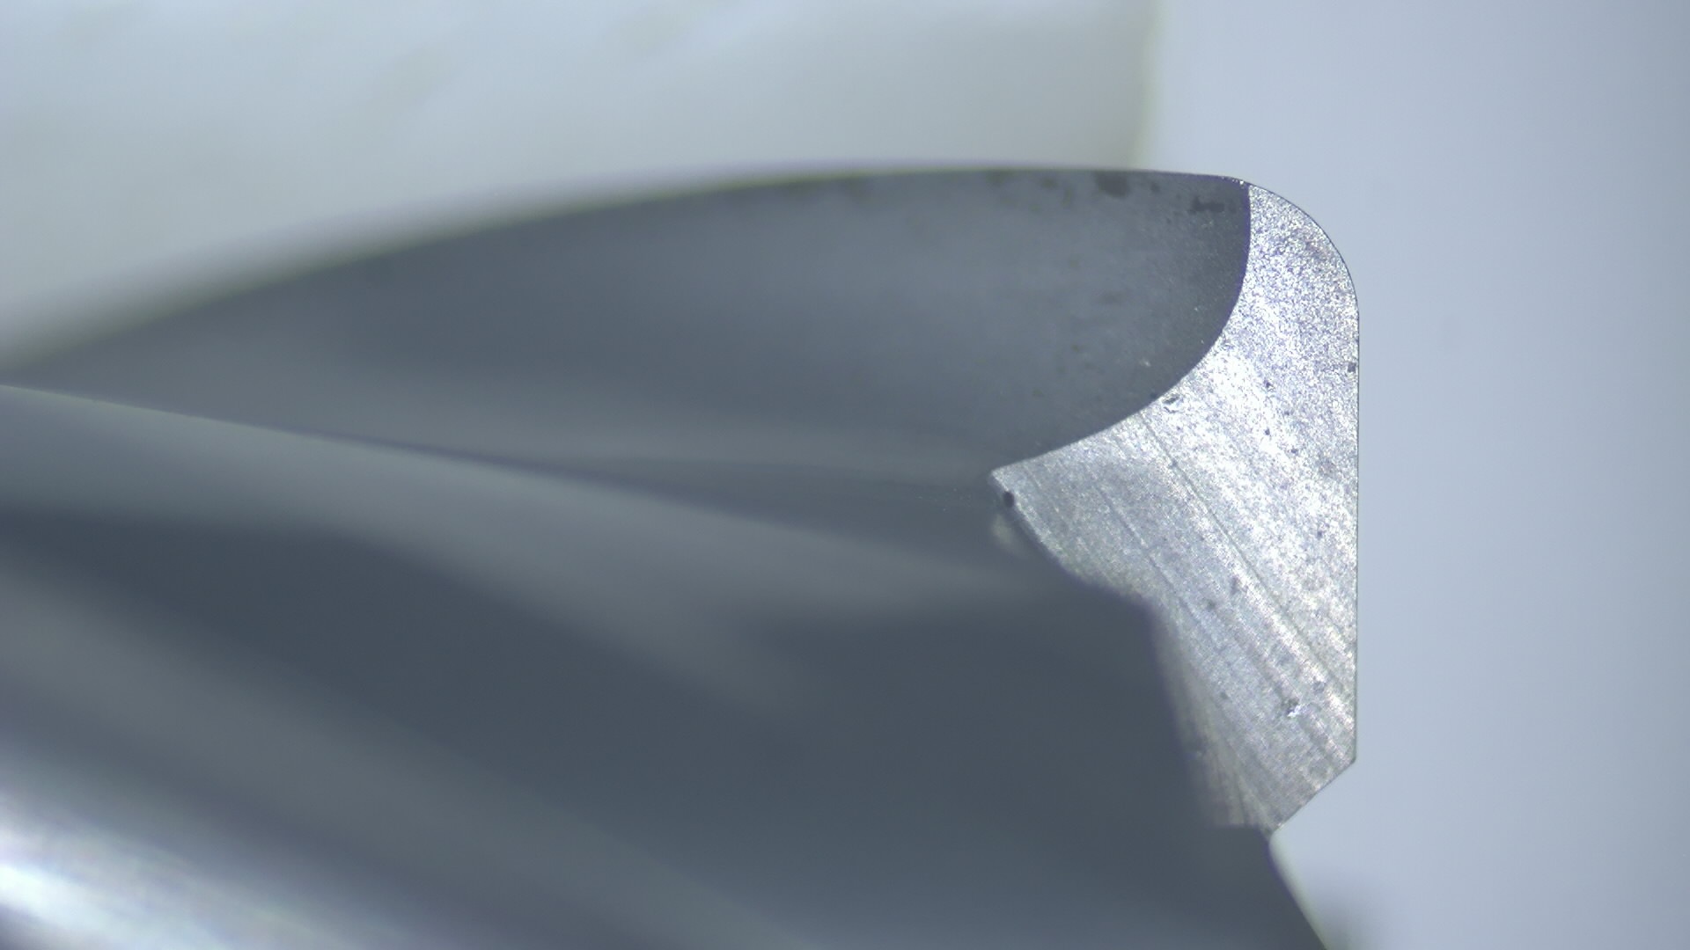
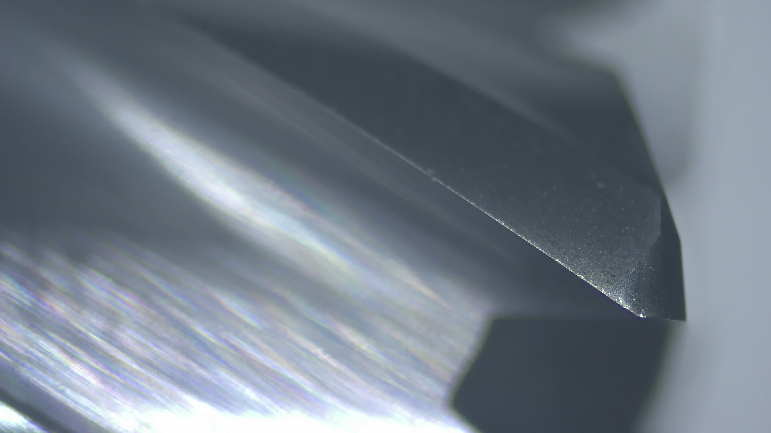
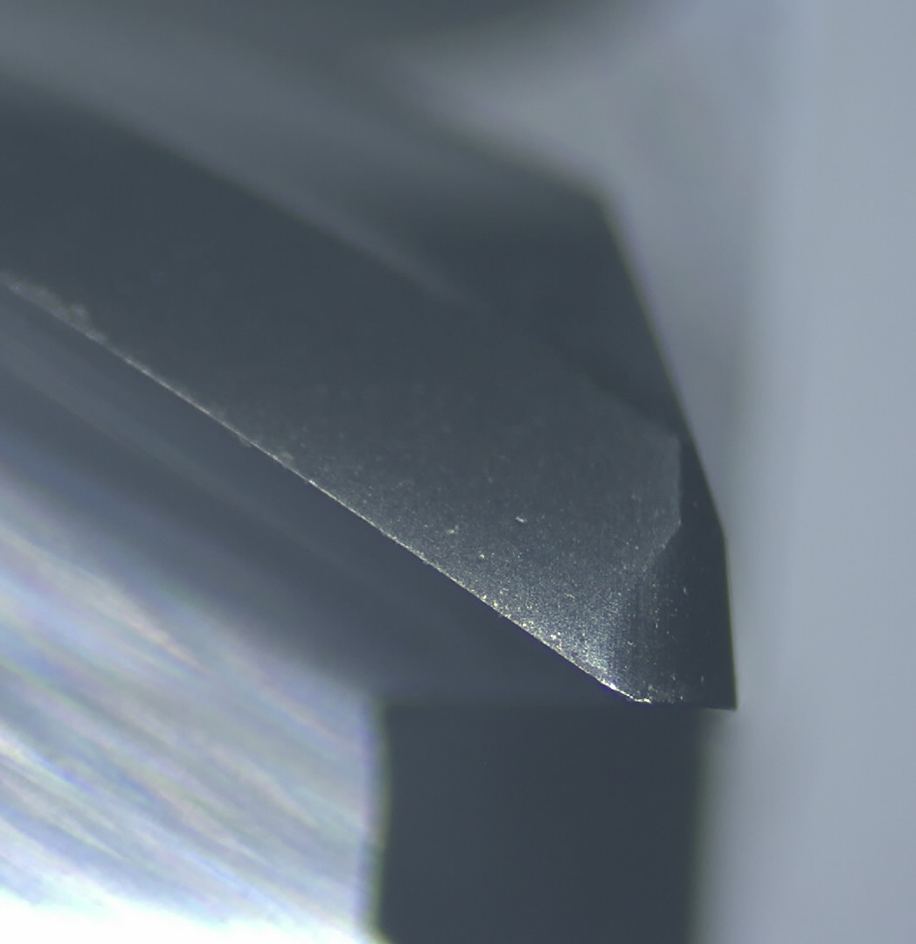
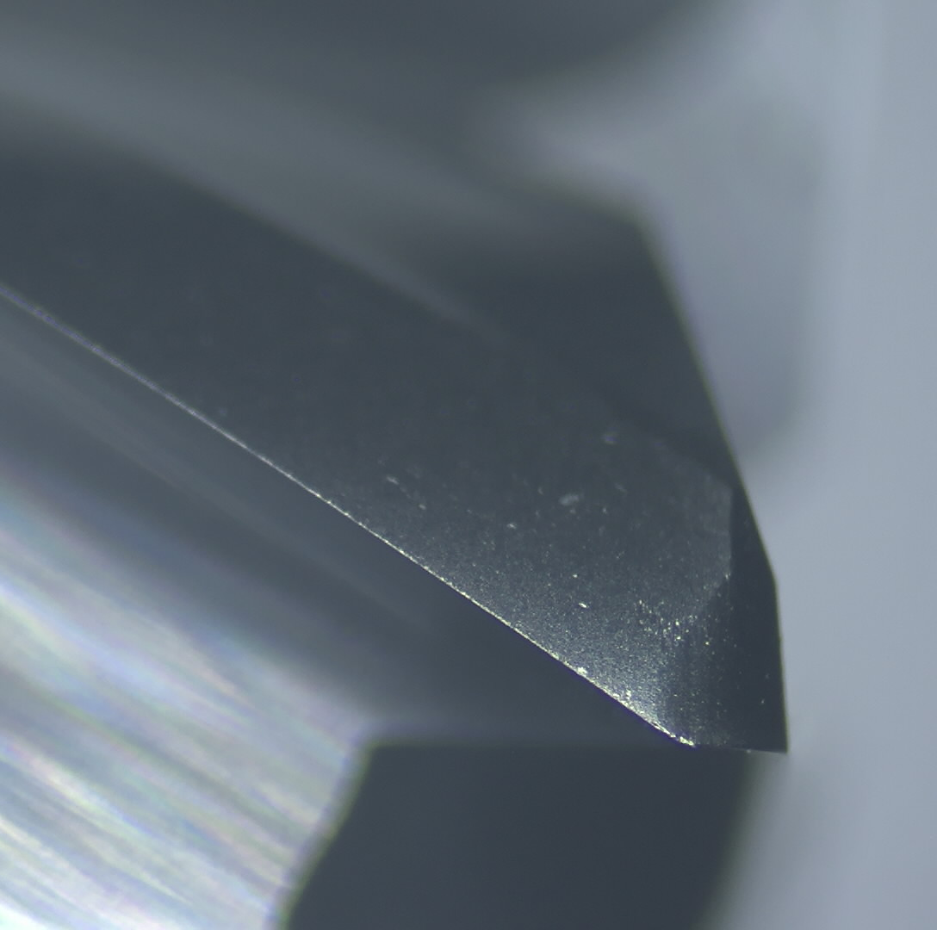
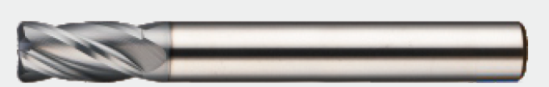
Successful Story – HGXR4- Poland
Machine：Quick Jet V70S
Holder： E50
Cutter： D6xR0,5x4t Radius Endmill
Material：1,2738HH, HRC46-48
Cutting： Z constant semi finishing
Coolant： Emulsion
Vc： 135 m/min
n： 7200 rpm
fz： 0,083mm/t
Vf： 2400mm/min
Ap: 0,03mm
Ae: 0,1mm
4 hours
HGXR4060R0.5 0650

Slide 13
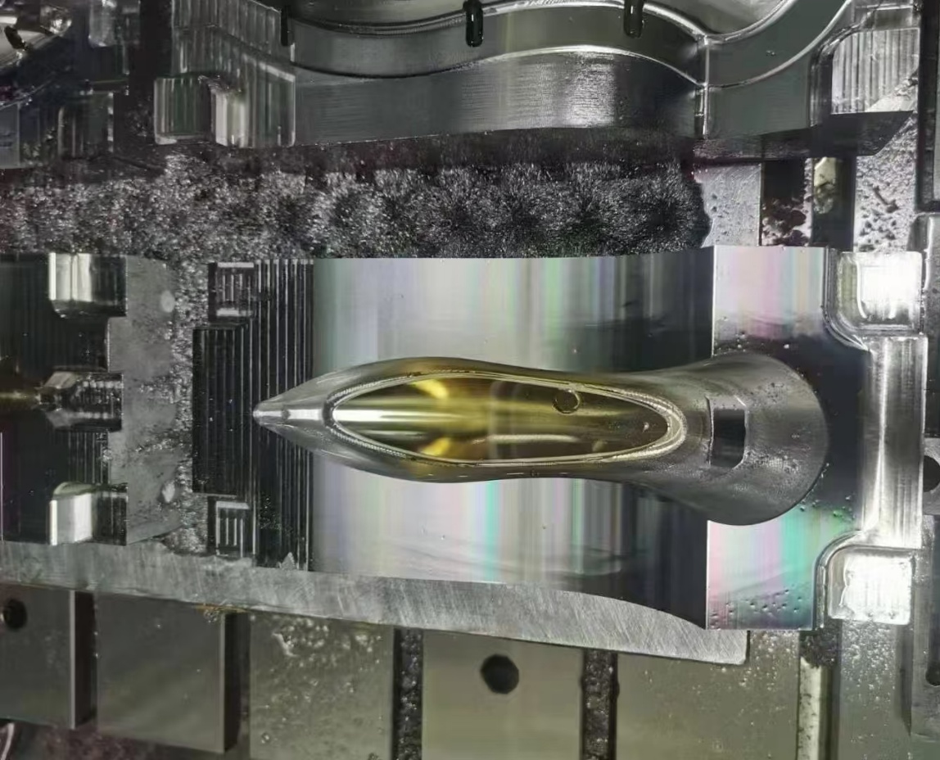
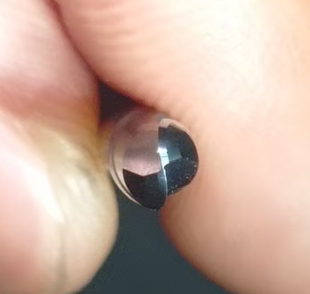
Successful Story – HGXB2 - Germany
Machine：Makino V33
Cutter： D4xR2x2t ball nose Endmill
Material：1.2083, HRC48-50
Cutting： Z constant semi finishing
Coolant： Emulsion
Vc： 113 m/min
n： 9000 rpm
fz： 0,11mm/t
Vf： 2000mm/min
Ap: 0,03mm
Ae: 0,1mm
After 25 hours 18 minutes

Slide 14


