Slide 1
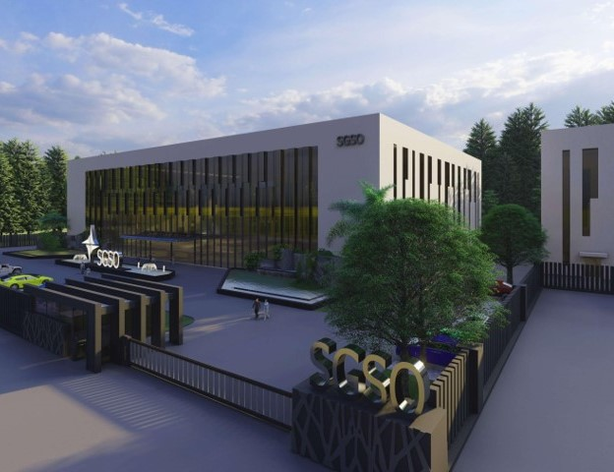


SGSO Technology
HGXPB
Tapered neck endmill
Notes:
Sustained Growth Smart Optimization

Slide 2
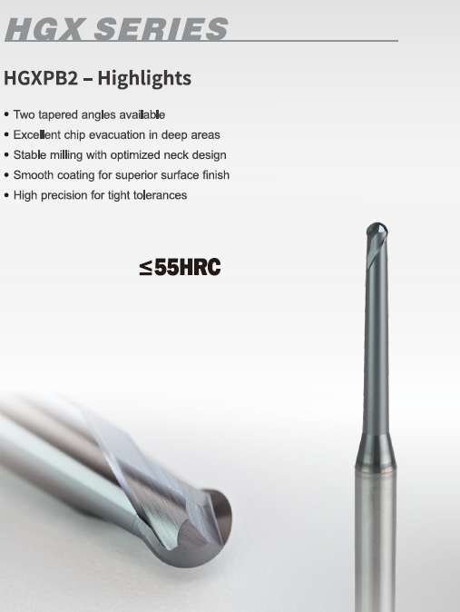
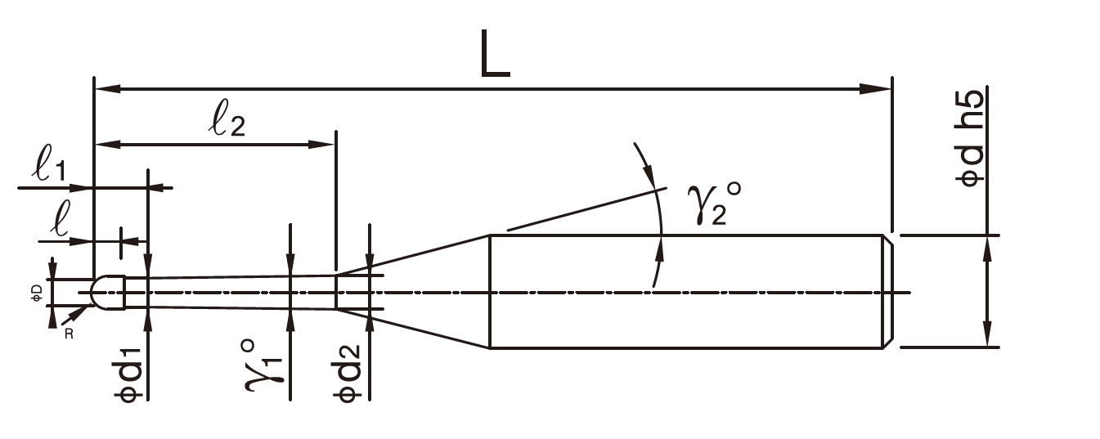


HGXPB Features
Dia 0.6mm-6mm
0.4°/0.9° two type of neck angles eusure higher stability

Slide 3
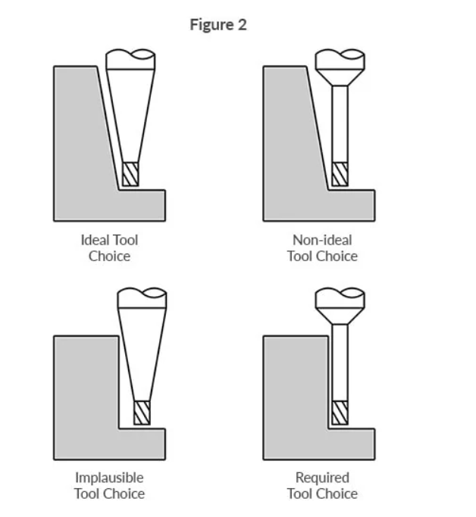
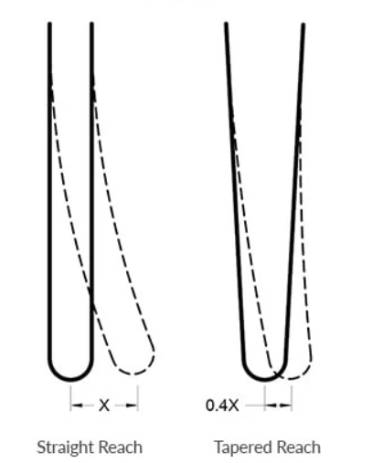
Tapered neck features
Inclined wall, tapered neck endmill has higher stability
Tapered neck tools have less deflection
and better machining precision
Straight wall, tapered neck endmill has shorter effective length
From https://www.harveyperformance.com/in-the-loupe/tapered-end-mills/

Slide 4


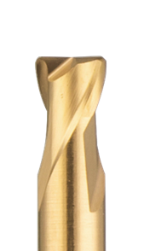


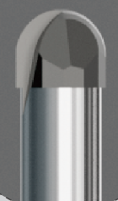

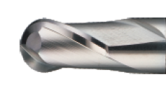

Deep Series

Slide 5


