Slide 1
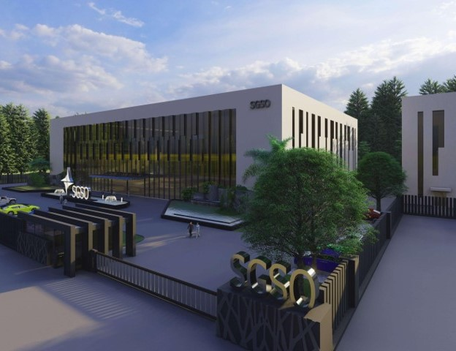

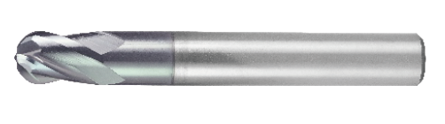
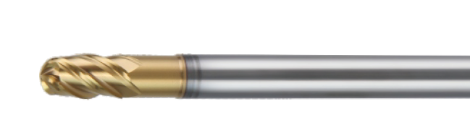
HSXBC4 & HGXB4
SGSO Technology
Notes:
Sustained Growth Smart Optimization

Slide 2

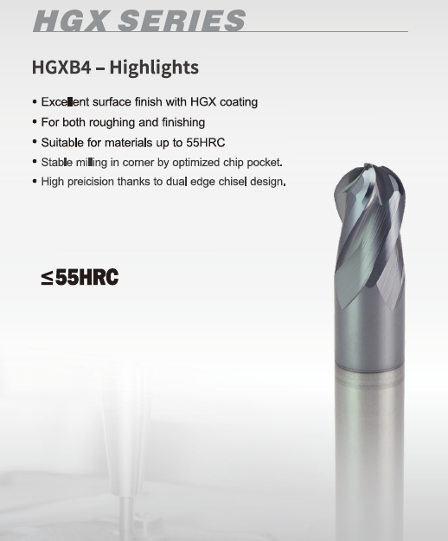
HSXBC4 and HGXB4 Features

Slide 3
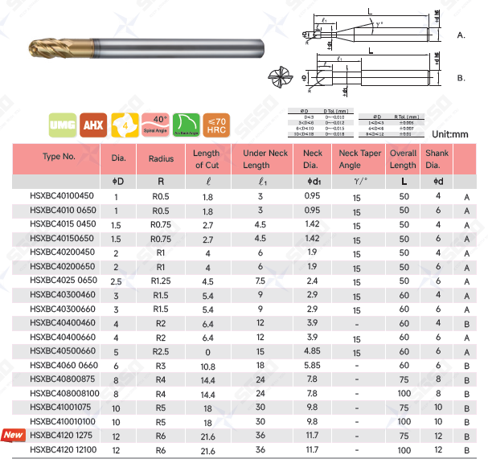
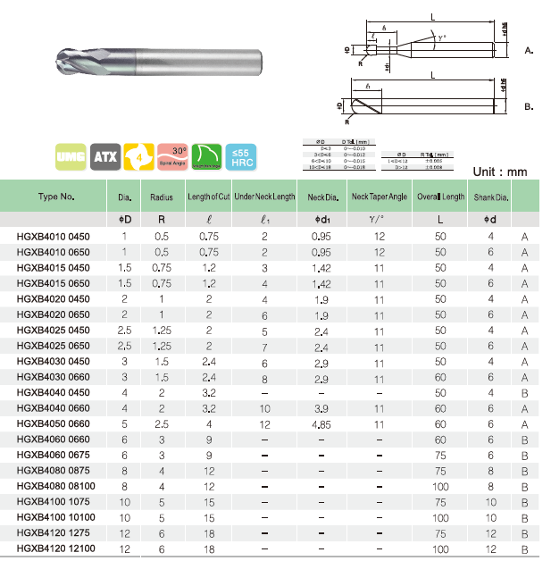
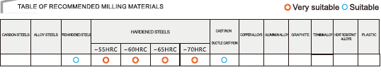
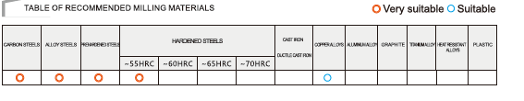
HSXBC4 and HGXB4 Line up

Slide 4
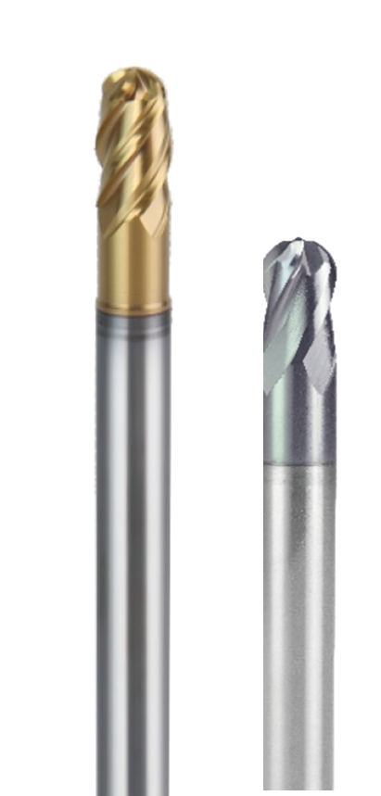


Comparison

Slide 5

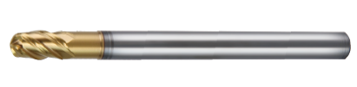


SGSO Ball nose endmill positioning
Hard Material
HSXB2
(2 flutes)
HSXBC4
(4 flutes)
high efficiency
Ultra-high efficiency
HGXB2
(2 flutes)
HGXB4
(4 flutes)
Soft Material

Slide 6


