Slide 1


SGSO Technology
Finishing Insert VSB & MSB
Notes:
Sustained Growth Smart Optimization

Slide 2
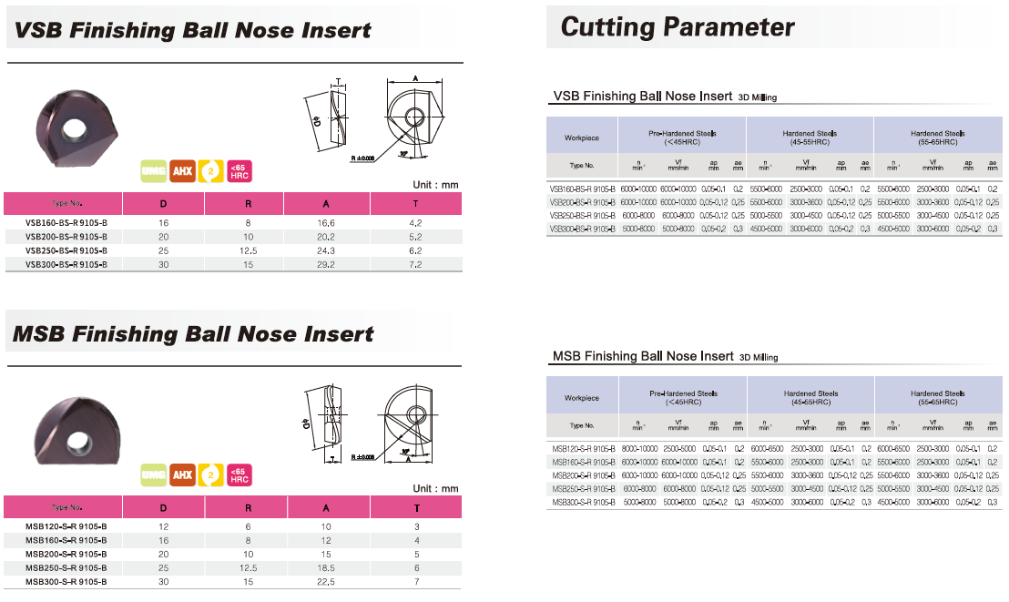
Specification (VSB & MSB)

Slide 3
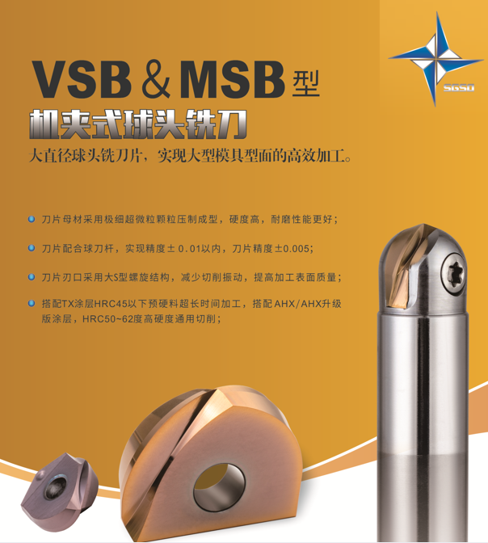
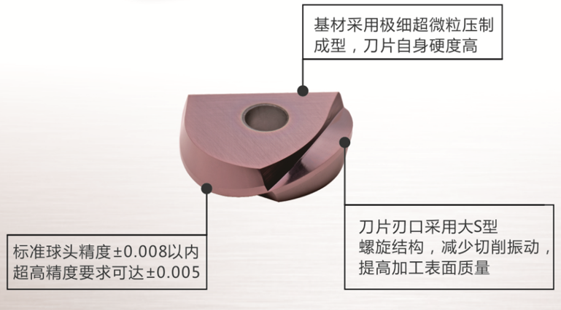
Features (VSB & MSB)
Ultra-fine micro-grain substrate offering high hardness and excellent wear resistance.
Clamping accuracy is within +/-0.01 mm, and insert itself can reach a maximum R tolerance of +/-0.005 mm.
The cutting edge adopts a large S-shaped spiral geometry, which reduces cutting force and vibration while improving the surface finishing quality.
Thanks to AHX coating, Insert can maintain stable performance when machining materials with hardness between HRC50–62.
Chisel geometry combined with sharpness and toughness leads to stable performance in flat face finishing
A precision-ground surface ensures high-accuracy clamping
Optimized flute geometry guarantee smooth chip evacuation and avoids re-cutting
The side cutting edge adopts a teardrop shape, which reduces the contact area between the side edge and the workpiece, thereby decreasing cutting vibration

Slide 4

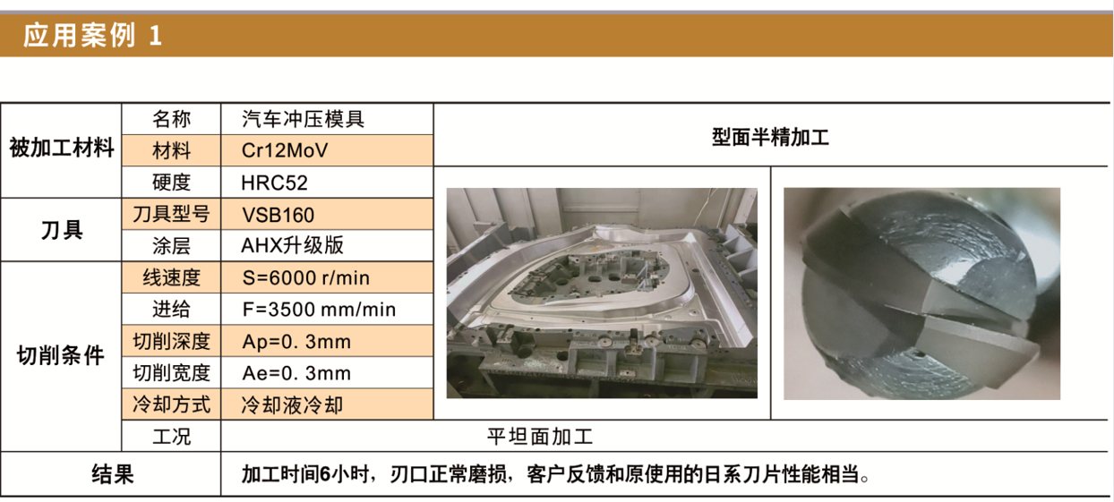
Successful Story
MSB160-9105B
Cutter： R8x2t Ball nose
Material：1.2379 HRC52
Cutting： Auto press mold
Coolant： Emulsion
Vc： 300 m/min
n： 6000 rpm
fz： 0,29mm/t
Vf： 3500mm/min
ap： 0,3mm
ae： 0,3mm
After 360min

Slide 5
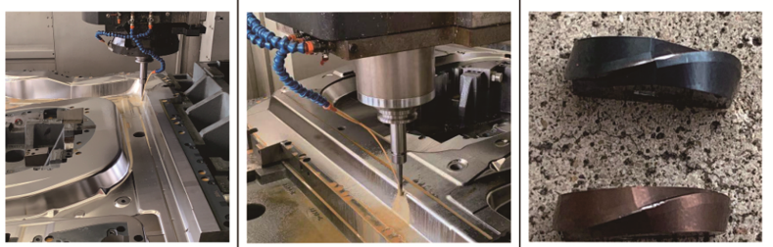
Successful Story
Cutter： R6x2t Ball nose
Material：1.2379 HRC52
Cutting： Auto press mold
Coolant： Emulsion
MSB160-9105B
Vc： 300 m/min
n： 8000 rpm
fz： 0,188mm/t
Vf： 3000mm/min
ap： 0,1mm
ae： 0,2mm
Competitor (720m)
MSB 160 9105B (720m)
Notes:
BNM120-DH102 Dijet

Slide 6
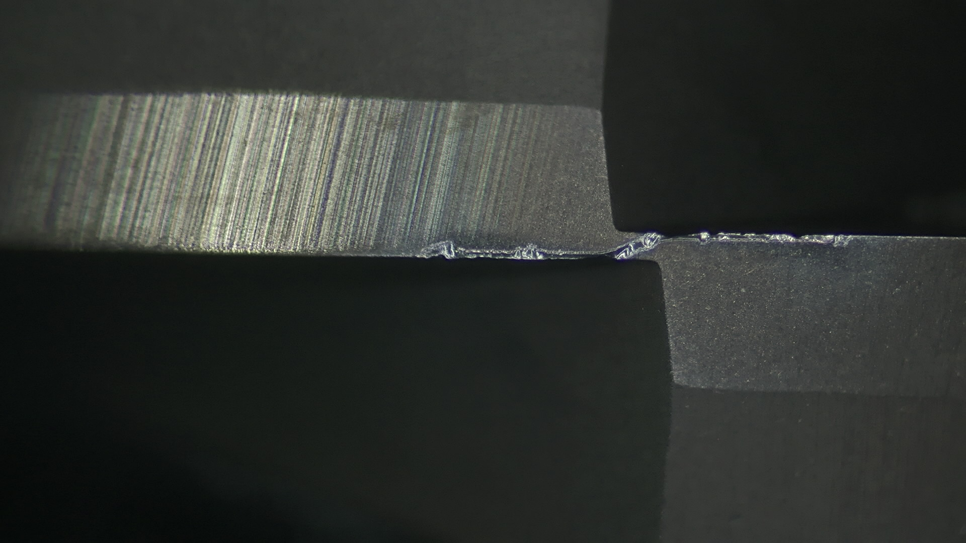
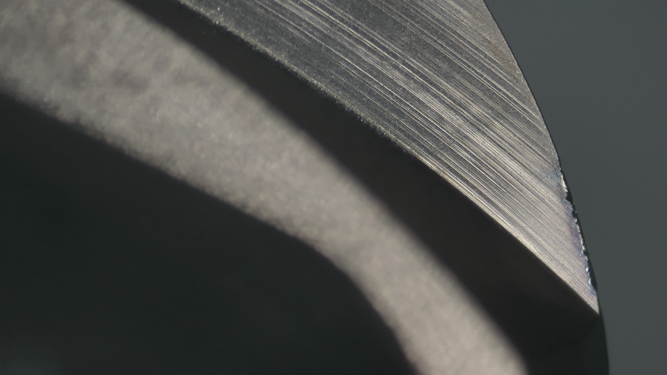
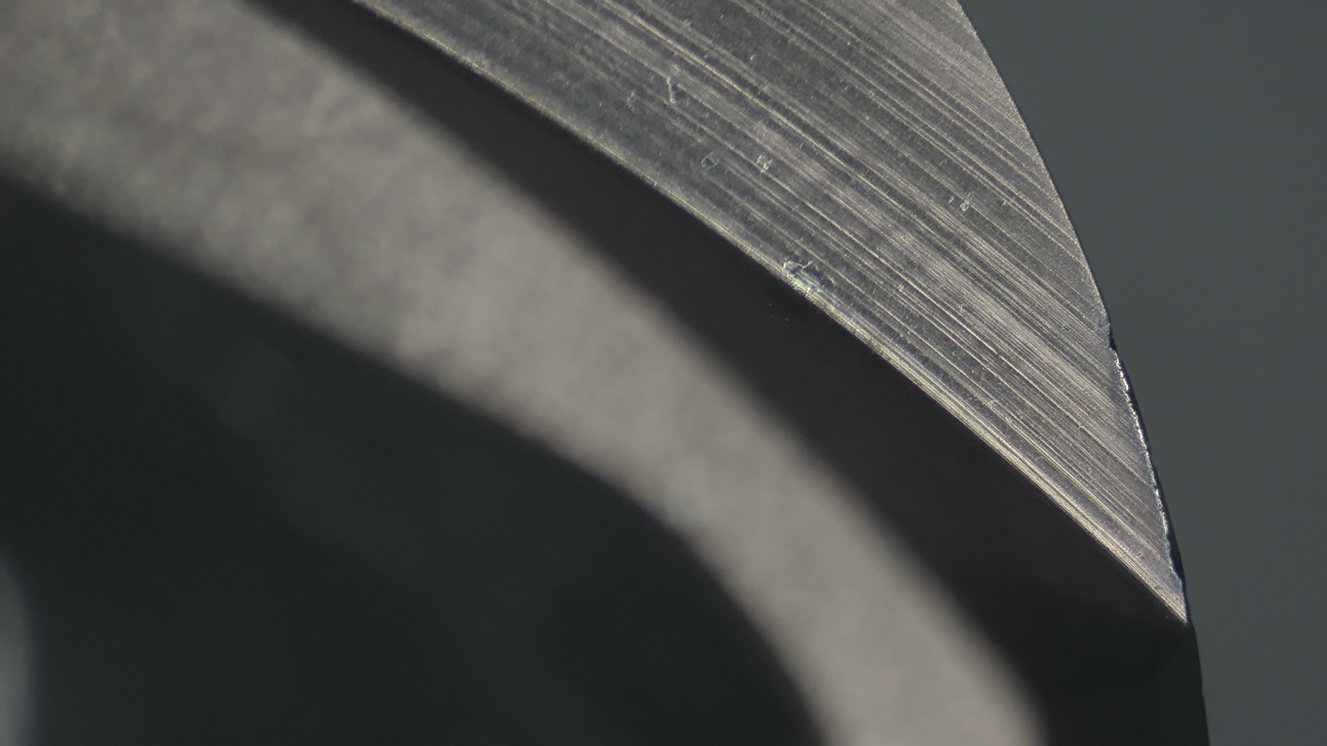
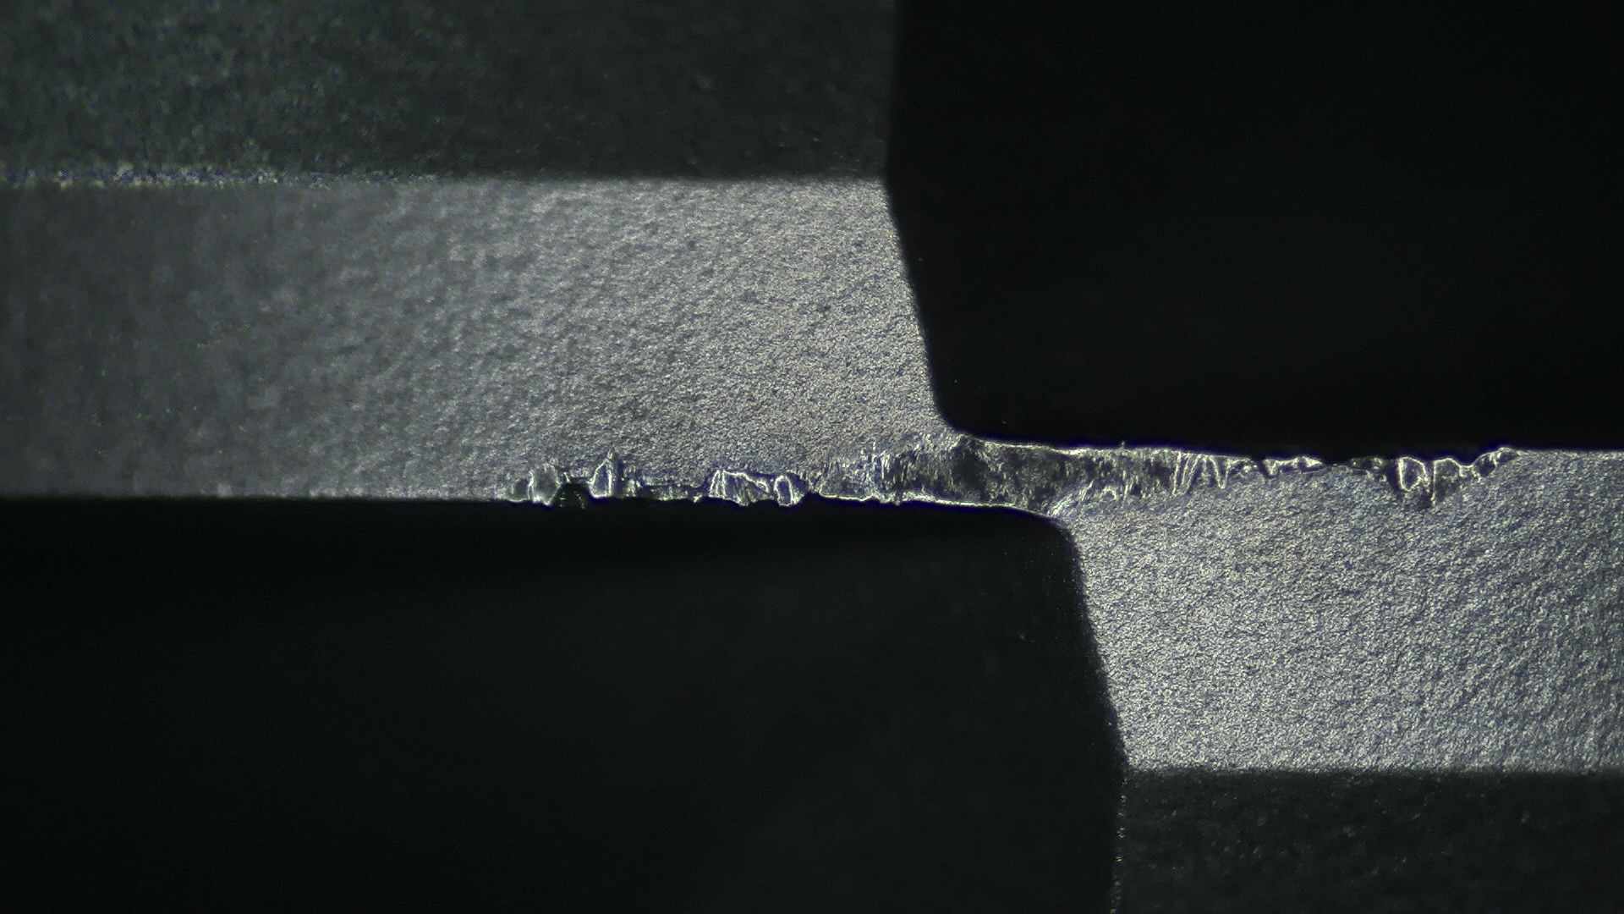
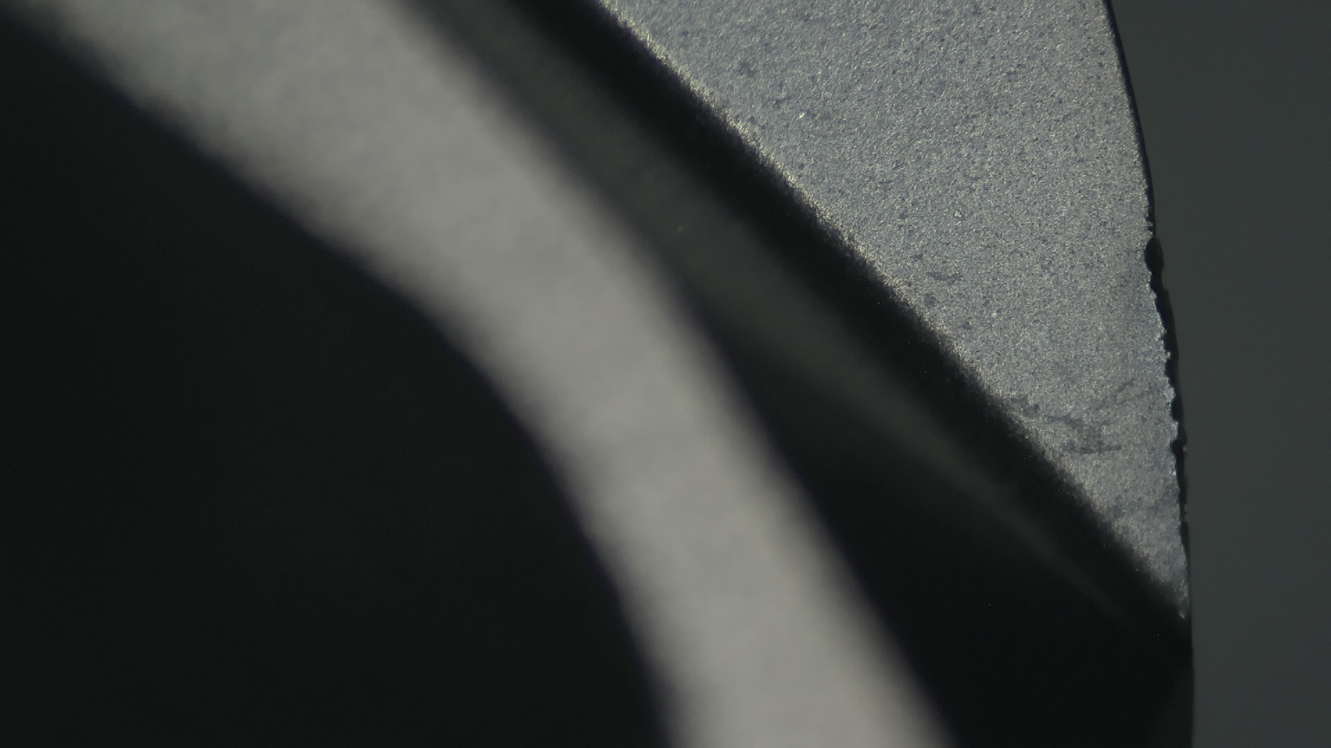
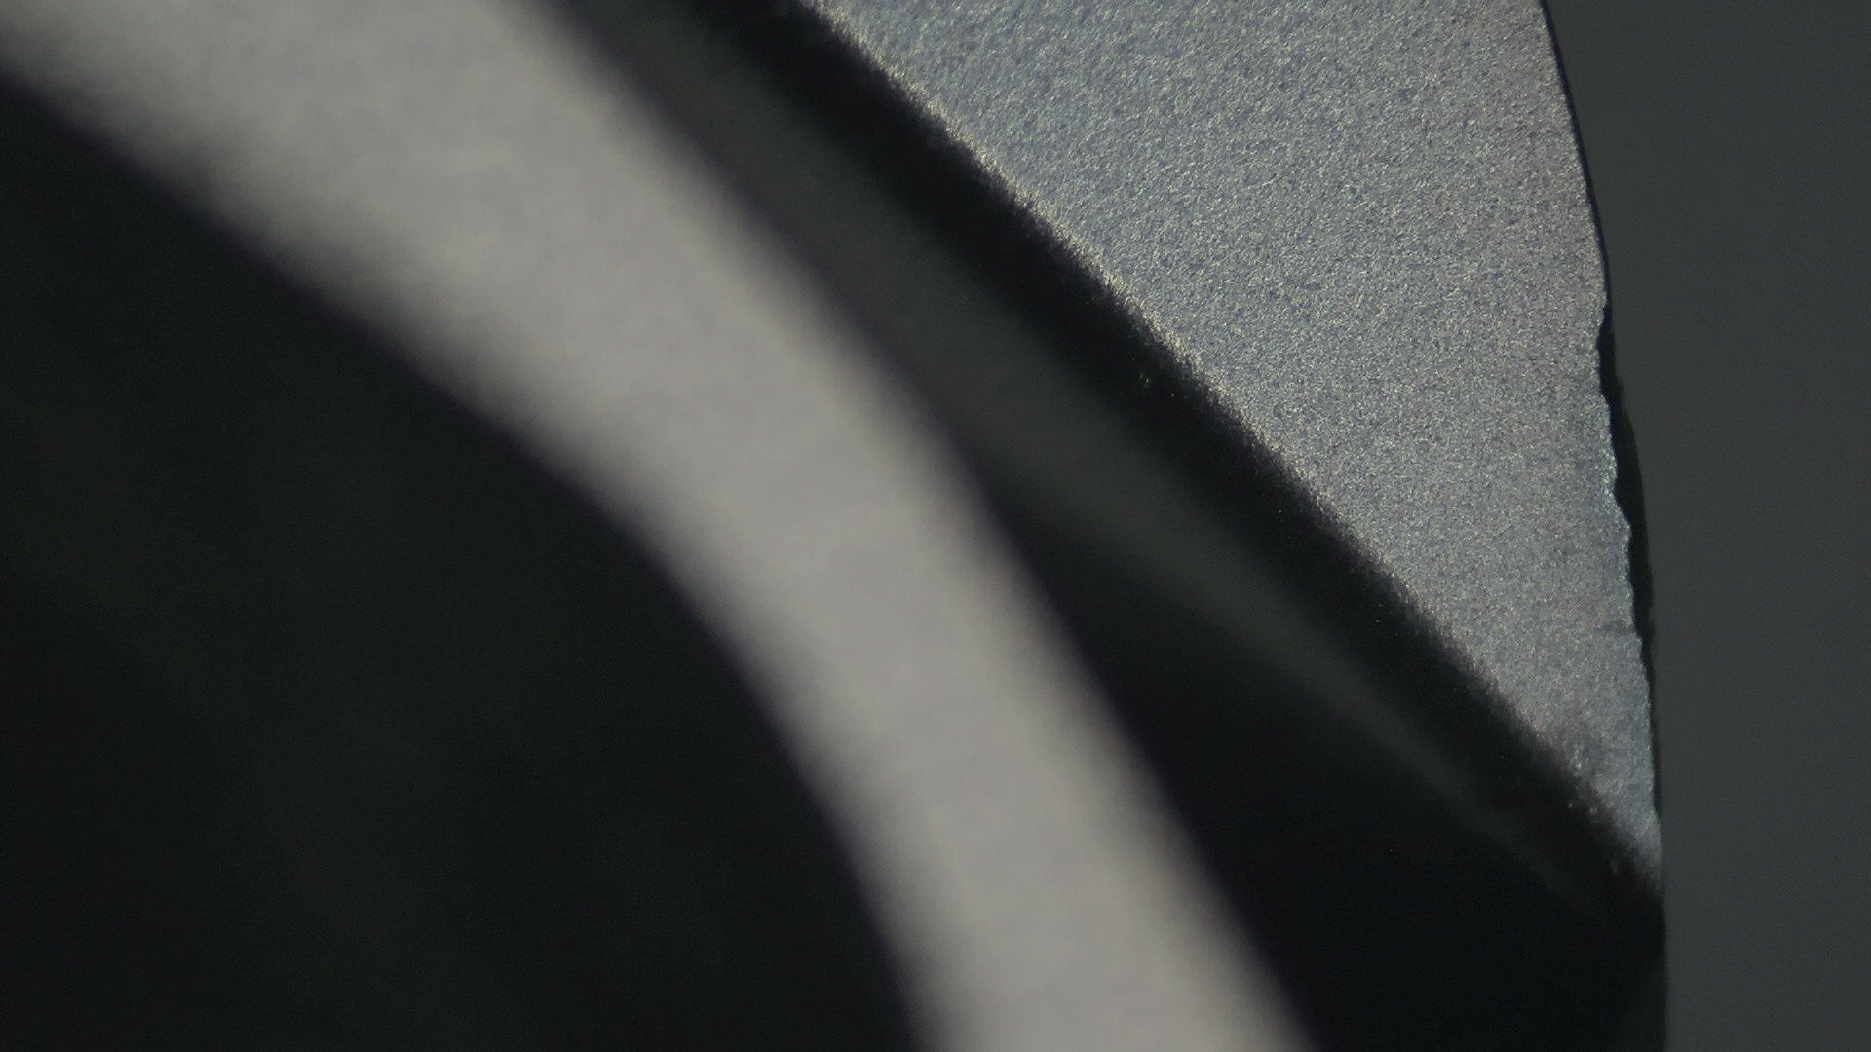
Successful Story
MSB 160 9105B (340m)
Cutter： R8x2t Ball nose
Material：1.2379 HRC60
Cutting： Face Finishing
Coolant： Airblow
MSB160-9105B
Vc： 250 m/min
n： 5000 rpm
fz： 0,24mm/t
Vf： 2400mm/min
ap： 0,1mm
ae： 0,2mm
Competitor BNM 160 DH202 (340m)

Slide 7
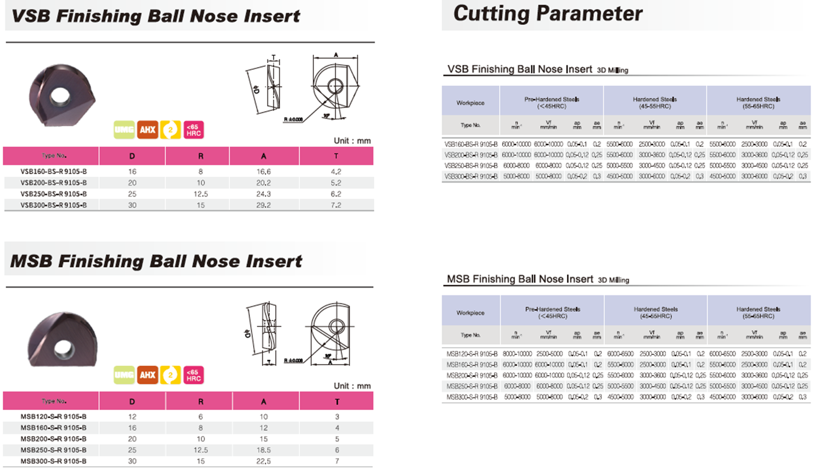



Replacable Insert on the holder
on holder
VSB
on holder
MSB

